Slide 1
Questions
Why an elephant always gives birth only to a baby elephant and not some other animal?
Why a mango seed forms only a mango plant and not any other plant?
Why are the offsprings identical to their parents?
Why do the organisms show differences in some of their characteristics?
Why siblings sometimes look so similar to each other?
Why siblings sometimes look so different?

Slide 2
GENETICS AND EVOLUTION
Genetics: Study of heredity and variation
Evolution (Descent with modification):
Process of gradual change in heritable features of population over successive generation.
Evolution is a Long term consequences of accumulation of variation.

Slide 3
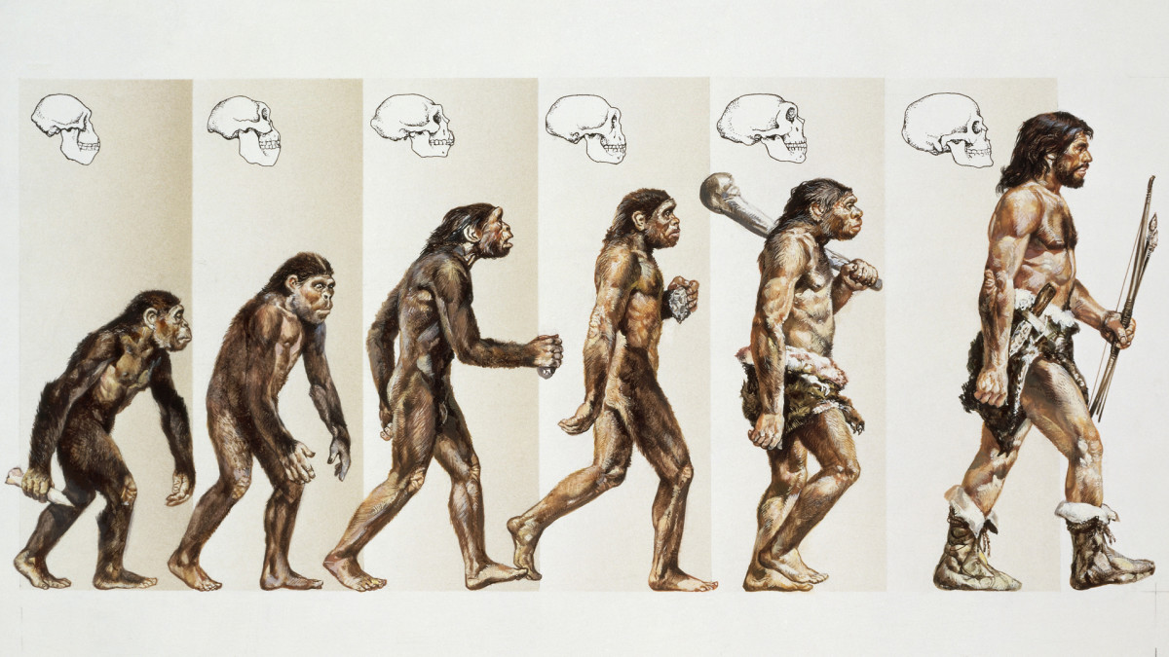
Causes of variation is mainly due to sexual reproduction in sexually reproducing organisms.
What do you think are the causes of variation?
Evolution---→
Sexual reproduction  Variation  Speciation

Slide 4
Terminology
Inheritance is the process of passing of traits from parents/ancestors to offspring.
Heredity is the mechanism by which variations are created and inherited. Heredity occurs through inheritance of genes i.e Inheritance is the basis of heredity.
Variation is the degree by which progeny differ from their parents.
Inherited traits: Traits that are passed down from generation to another. For examples; eye colour (black, brown, blue), height (tall, dwarf), Ear lobes (free, attached).

Slide 5
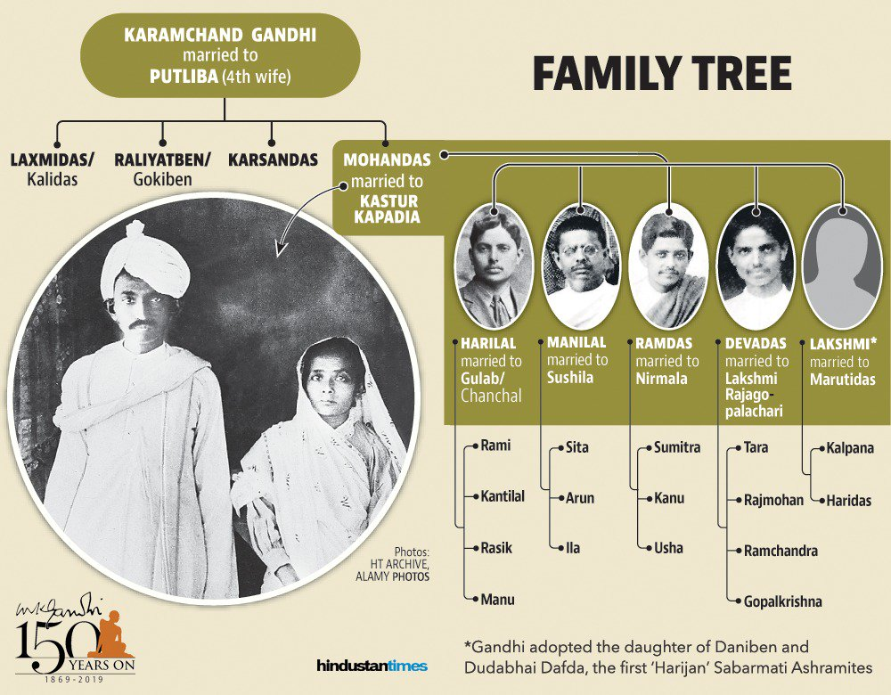
Inheritance and the variation of characters from parents to offspring

Slide 6
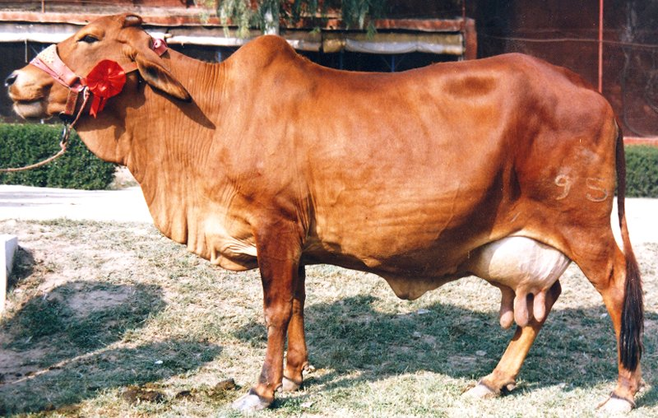
Read 4th paragraph of page no. 69
Humans knew that one of the causes of variation was hidden in sexual reproduction as early as 8000-1000 B.C. .
They exploited the variations in the wild populations of plants and animals
They selectively breed and select organisms that possessed desirable characters. For example, Sahiwal –a well-known Indian breed cow in Punjab (produced by artificial selection for desirable characters and domestication from ancestral wild cows).
Though Indian ancestors knew about the inheritance of characters and variation, they had very little idea about the scientific basis of inheritance and variation.
Notes:
The Sahiwal (Zebu: humped cattle)originated in the dry Punjab region which lies along the Indian-Pakistani border. They were once kept in large herds by professional herdsmen called "Junglies". With the introduction of irrigation systems to the region they began to be kept in smaller numbers by the farmers of the region, who used them as draught and dairy animals. Today the Sahiwal is one of the best dairy breeds in India and Pakistan. Due to their heat tolerance and high milk production they have been exported to other Asian countries as well as Africa and the Caribbea

Slide 7
How do traits get inherited?
First answered by Gregor Johan Mendel (1832-1884) –The father of genetics.
Mendelian Inheritance
Proposed three laws (principles/Rules) of inheritance as follows;
First Law or Law of Dominance
Second Law or Law of Segregation
Law of Independent Assortment
Based on Mendel’s observations on monohybrid crosses
Based on Mendel’s observations on dihybrid crosses

Slide 8
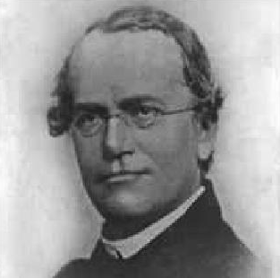
GREGOR JOHAN MENDEL
Known as the father of modern genetics.
Studied seven pairs of inherited characteristics in garden pea (Pisum sativum) for seven years (1856-1863) and proposed the laws of inheritance in living organisms.
Although the significance of his work was not recognized during his lifetime, it has become the basis for the present day field of genetics.
1832-1884

Slide 9
Mendel’s investigations into inheritance patterns
Mendel was the first to use statistical analysis and mathematical logic to solve problems in biology.
His experiments had a large sampling size, which gave greater credibility to the data that he collected.
Investigated characters in pea plants that have two opposite traits, e.g., tall or dwarf plants, yellow or green seeds.
Inference of his experiment provided general rules of inheritance.

Slide 10
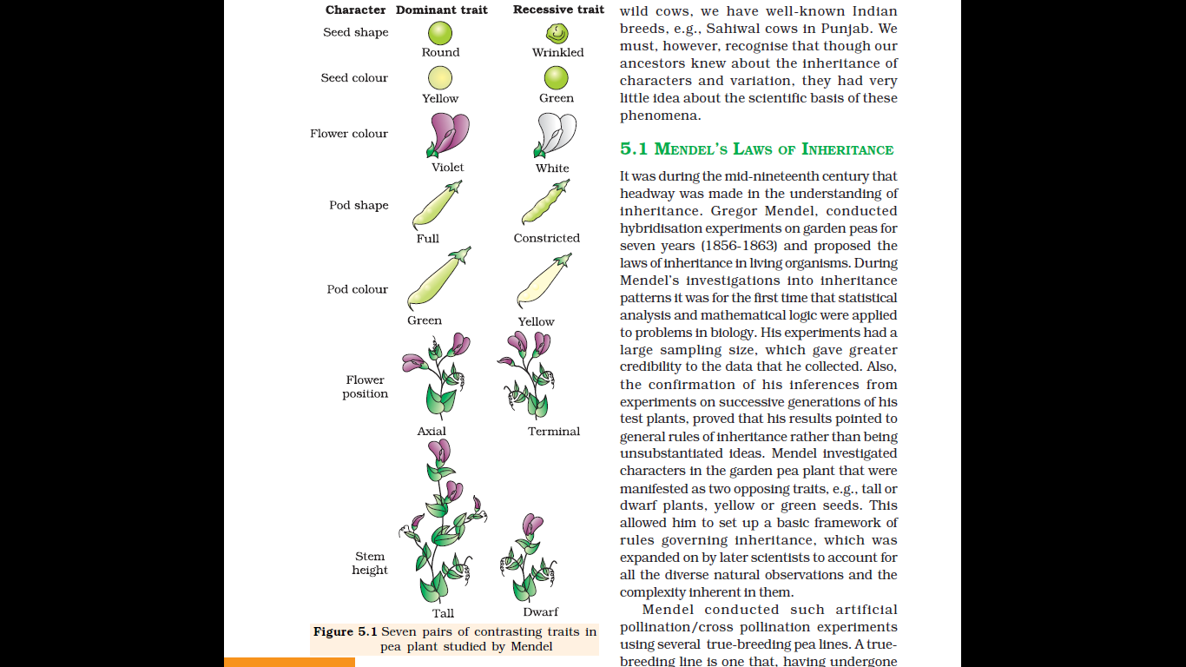
Seven Pairs Of Contrasting Traits (14 true-breeding pea plant varieties) Studied By Mendel

Slide 11
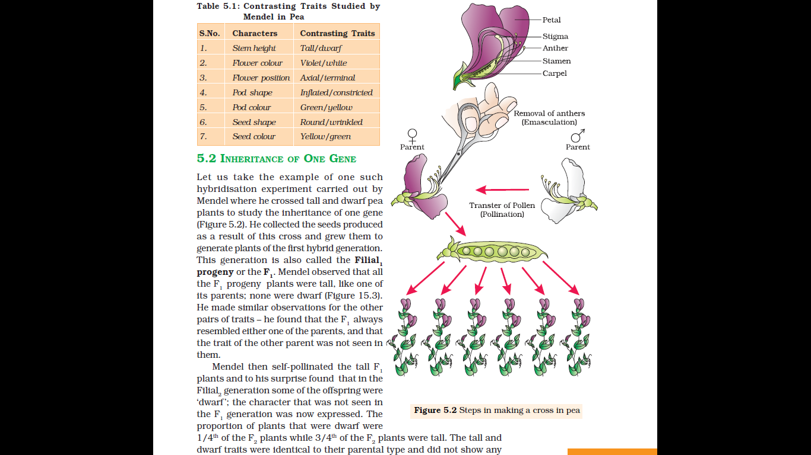
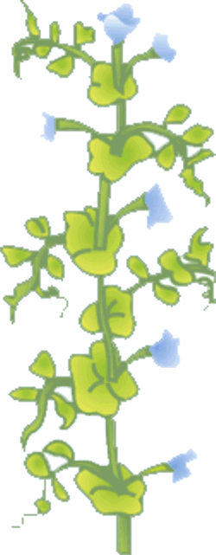
Mendel’s approach of artificial cross pollination of garden pea using true-breeding pea lines* to study inheritance
*A true breeding line/plant is the plant that have undergone continuous self-pollination, and shows the stable trait inheritance and expression for several generations.
Notes:
Filial: generation/progeny

Slide 12
Terminology
Phenotype (Greek phainein, meaning "to show", typos, meaning "type")
Genotype
Monohybrid cross
Dihybrid cross
Observable characteristics or traits. Example tallness and dwarfness of height of a plant
Set of genes in DNA which is responsible for a particular trait
Cross between two true breeding parents for a trait
Cross between two true breeding parents for two traits

Slide 13
Terms to be remembered
Terms | Meaning | Example
Locus
Alleles/Allelomorphs
Homozygous alleles
Heterozygous alleles
Homozygous dominant alleles
Homozygous recessive alleles
Address/location of a gene in a chromosome
T, A, B, d, etc
Alternative/slightly different forms of a gene
OR
Genes which code for a pair of contrasting traits
T and t or A and a etc
Both alleles of a gene at a locus are similar
AA or aa
Both alleles of a gene at a locus are dissimilar
Aa or Tt etc
Both alleles of a gene at a locus are similar and dominant
AA
Both alleles of a gene at a locus are similar and recessive
aa

Slide 14
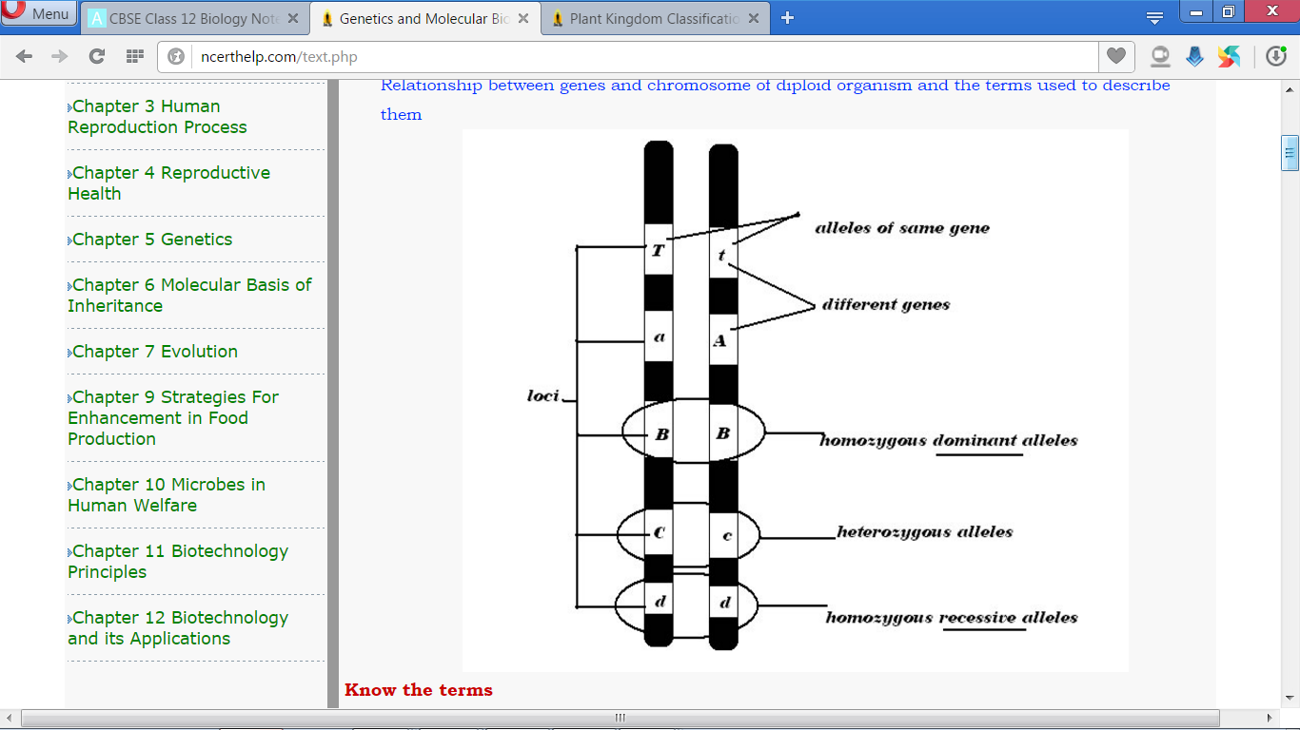

Slide 15
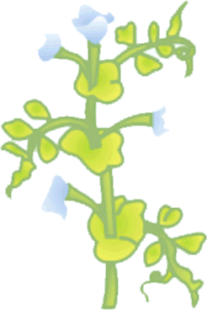
Mendel’s inheritance Of Gene Of Height In Pea Plant (Monohybrid Cross)
Parents
Tall (TT)
Short (tt)
F₁ generation
Tall (Tt)
Tall (Tt)
Tall (Tt)
Tall (Tt)

Slide 16
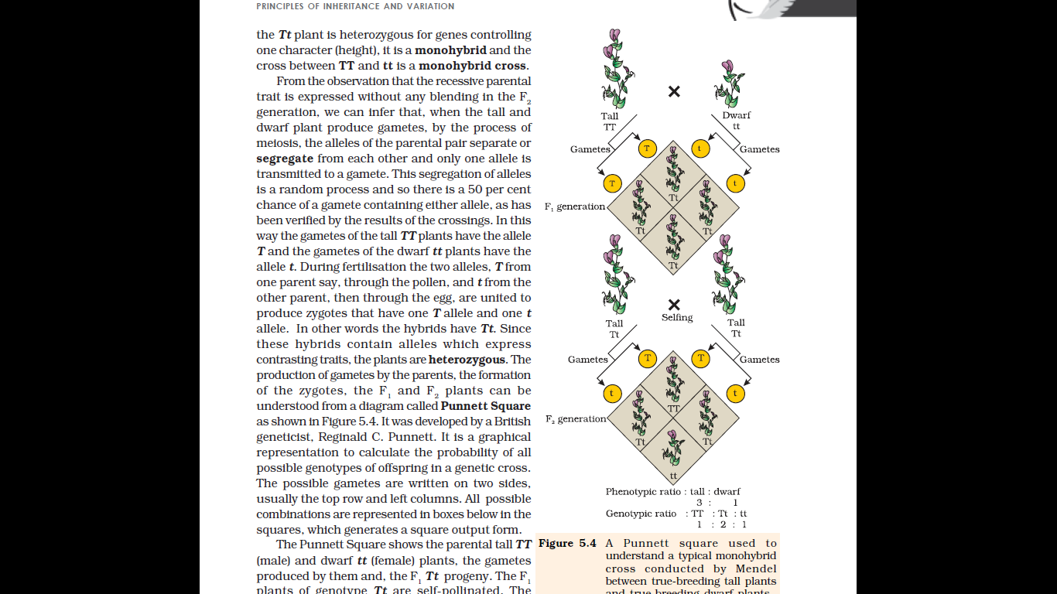
^{…… continuation} Inheritance Of Gene Of Height In Pea Plant (Monohybrid Cross)
F₁ generations on selfing
Tall (Tt)
Tall (Tt)
F₂ generation
Proportion of F₂ plants
Dwarf | Tall
1/4 | 3/4
Tall (TT)
Tall (Tt)
Tall (Tt)
Short (tt)

Slide 17
Dominant and Recessive traits
Dominant trait
Expressed trait
Takes over the other inherited trait
For example, ‘Tall’ is a dominant trait of pea plants
Recessive trait
Unexpressed/hidden trait
Trait dominated by the dominant trait
For example, ‘Dwarf’ is a recessive trait of pea plant

Slide 18
Inheritance Of Gene Of Height In Pea Plant (Monohybrid Cross) studied by Mendel

Slide 19
Summary; MENDEL’S APPROACH
Hybridised/cross-pollinated plants with alternate forms of a trait
Used the seeds to generate F₁ generation.
Self pollinated F₁ offsprings to produce F₂ generation.
Conducted test crosses.

Slide 20
Inference of Mendel
Only one of the parental traits was expressed in the F₁ generation.
At the F₂ stage both the parental traits were expressed in the proportion 3:1.
The contrasting traits did not show any blending at either F₁ or F₂ stage.

Slide 21
Factors to genes ($≃$Alleles/Allelomorphs)
Mendel proposed that something was being stably passed down, unchanged, from parent to offspring through the gametes, over successive generations. He called these things as ‘factors’.
Nowadays, we call them as genes.
What is gene? (According to you)
Genes are the units of inheritance i.e. genes contain the information that is required to express a particular trait, in an organism. Structurally, genes are segment of DNA.

Slide 22
Principles or Laws of Inheritance
Based on Mendel’s observations on monohybrid crosses, he proposed two general rules to consolidate his understanding of inheritance in monohybrid crosses.
Today these rules are called the Principles or Laws of Inheritance:
First Law or Law of Dominance
Second Law or Law of Segregation.

Slide 23
Law of Dominance
Characters are controlled by discrete units called factors.
Factors occur in pairs.
In a dissimilar pair of factors one member of the pair dominates (dominant) the other (recessive).
The law of dominance is used to explain
the expression of only one of the parental characters in a monohybrid cross in the F₁ generation
the expression of both the parental characters in the F₂ generation
the proportion of 3:1 obtained at the F₂.
Notes:
F1 resembled either of the two parents (dominance)

Slide 24
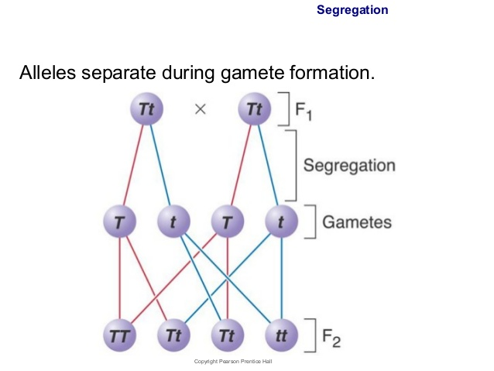
Law of Segregation
Though the parents contain two alleles, during gamete formation the factors or alleles of a pair segregate from each other such that a gamete receives only one of the two factors.
This law was proposed based on the fact that
the alleles do not show any blending
both the characters are recovered as such in the F₂ generation though one of these is not seen at the F₁ stage.
Parental alleles
Gametic alleles
Fertilisation
Zygotic/hybrid alleles
Notes:
based on the fact that the alleles do not show any blending and that both the characters are recovered as such in the F₂ generation though one of these is not seen at the F₁ stage.

Slide 25
Law of Segregation
TT
A homozygous parent produces similar gametes.
A heterozygous parent produces two kinds of gametes each having one allele with equal proportion.
T
T
Tt
T
t

Slide 26
Make a cross showing the inheritance pattern of flower colour in garden pea plant
Inheritance of flower colour in garden pea shows true dominance. In F₁ generation, dominant violet colour (shade of purple) is expressed and in F₂ generation both dominant (violet) and recessive (white) colour are expressed in the ratio of 3 : 1.
Violet flower
(WW)
White flower
(ww)
Parental alleles
X
Gametes
W or W
w or w
F₁ generation
Ww
On selfing
F₂ generation
Gametes | W | w
W | WW (Violet flower ) | Ww (Violet flower )
w | Ww (Violet flower ) | ww (White flower)
Phenotypic ratio: Violet flower: White flower
3:1
Genotypic ratio: WW: Ww: ww
1 : 2 : 1

Slide 27
Monohybrid cross for seed coat colour as a trait in Pisum sativum (Garden pea)
Parental alleles
Yellow seed
(YY)
Green seed (yy)
X
Gametes
Y or Y
X
y or y
F₁ generation
Yy
On selfing
Gametes | Y | y
Y | YY (Yellow seed) | Yy (Yellow seed)
y | Yy(Yellow seed) | Yy (Green seed)
F₂ generation
Phenotypic ratio= Yellow seed : Green seed
3:1
Genotypic ratio = YY: Yy: yy
1 : 2 : 1

Slide 28
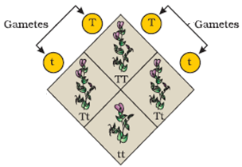
Punnett Square
It is a graphical representation to calculate the probability of all possible genotypes of offspring in a genetic cross
Developed by a British geneticist, Reginald Crundall Punnett.
Punnett Square is used for understanding
the production of gametes by the parents,
the formation of the zygotes
The possible gametes are written on two sides, usually the top row and left columns.
Gametes | T | t
T | TT | Tt
t | TT | tt
Square output form showing all possible genotypic combinations developed by Reginald Crundall Punnett
Notes:
To predict outcomes of a cross

Slide 29
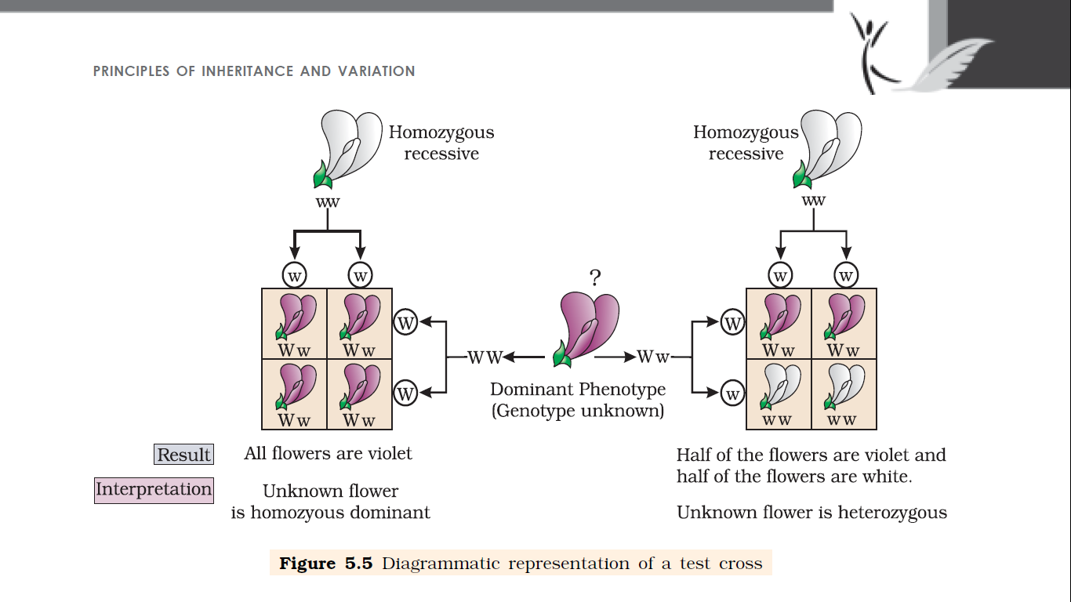
Test Cross
Test cross is a cross between dominant phenotypic plant with homozygous recessive plant that determines unknown genotype of the dominant phenotype.
Notes:
The genotypic ratios can be calculated using mathematical probability (Punnett square)
Can you tell the genotype by simply looking at the phenotype of a dominant trait, say a tall plant?
No, we can’t tell, we can’t predict whether a tall plant from F1 or F2 has TT or Tt composition.
Therefore, to determine the genotype of a tall plant at F2, Mendel crossed the tall plant from F2 with a true breeding line dwarf plant. This he called a test cross.
In a typical test cross, an organism (pea plants here) showing a dominant phenotype (whose genotype is to be determined) is crossed with the recessive parent instead of self-crossing. The progenies of such a cross can easily be analysed to predict the genotype of the test organism.

Slide 30
Representation of Test cross: for determining genotype of violet colour flower of pea plant
Violet coloured flower (W) is dominant over white coloured flower (w).

Slide 31
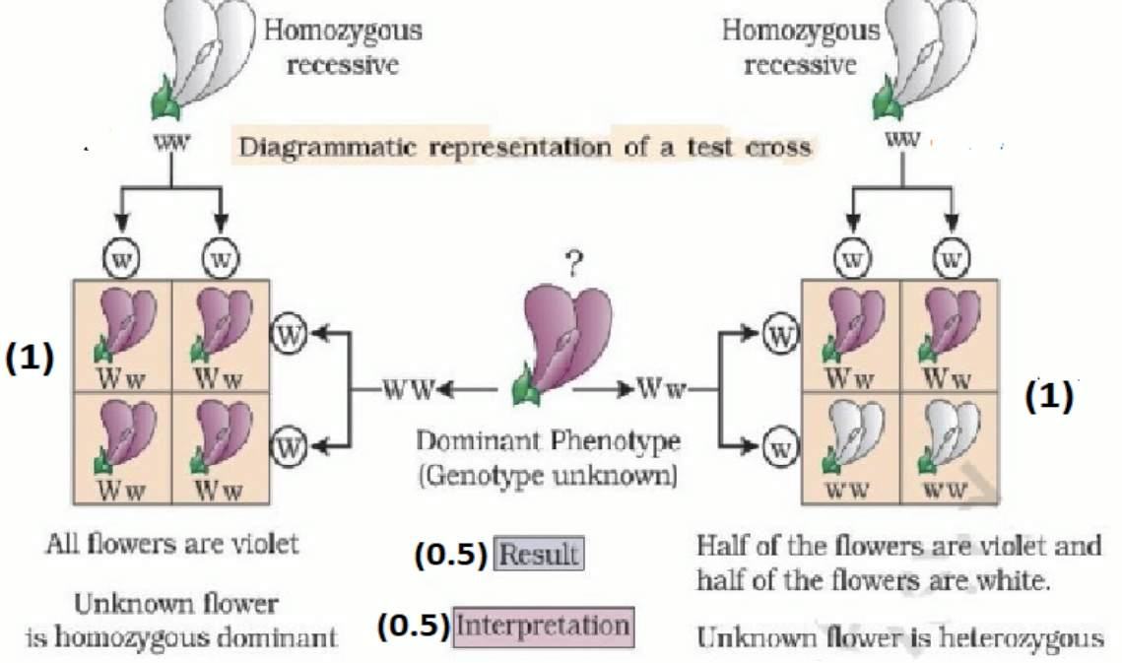
Frome Sample paper 2020-2021 How would you find out the genotype of a pea plant with violet flowers? Explain with the help of Punnets’ square showing crosses.

Slide 32
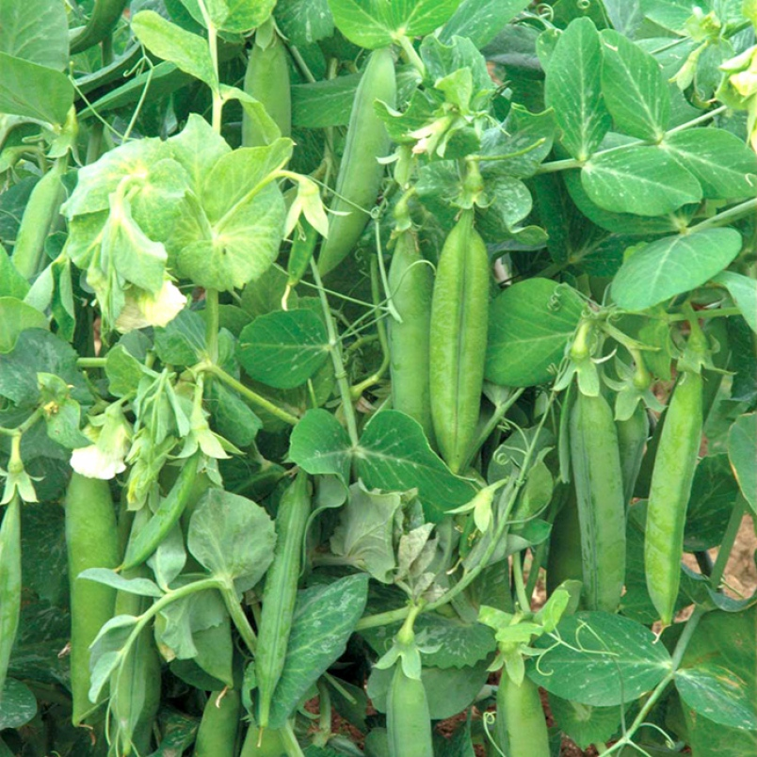
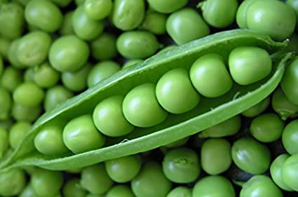
Mendel’s dihybrid cross (for studying inheritance of two traits/genes)
Parental alleles
Mendel crossed two true breeding pea parent plants differing in two pairs of contrasting traits:
seed colour and
seed shape
RRYY
(Round Yellow)
rryy
(Wrinkled Green)
Genotypic Symbols
Y : dominant yellow seed colour
y : recessive green seed colour
R : Dominant round shaped seeds
r : Recessive wrinkled seed shape.
Gametes
RY
ry
On selfing
F₁ generation
RrYy
(Round Yellow)
Gametes |  | Male
Female
F₂ generation
RY
rY
Ry
ry
Results of a dihybrid cross
Phenotypic ratio:
Round yellow : round green : wrinkled yellow : wrinkled green
9 : 3 : 3 : 1
RRYY
RrYY
RRYy
RrYy
RY
rY
RrYY
rrYY
RrYy
rrYy
Ry
RRYy
RrYy
RRyy
Rryy
Genotypic ratio:
RRYY : rrYY : Rryy : ryy
ry
RrYy
rrYy
Rryy
rryy
Notes:
Mendel found that the seeds resulting from the crossing of the parents, had yellow coloured and round shaped seeds (F₁ generation).
Thus, yellow colour was dominant over green and round shape dominant over wrinkled.
These results were identical to those that he got when he made separate monohybrid crosses between yellow and green seeded plants and between round and wrinkled seeded plants.
Let us use the genotypic symbols Y for dominant yellow seed colour and y for recessive green seed colour, R for round shaped seeds and r for wrinkled seed shape. The genotype of the parents can then be written as RRYY and rryy. The cross between the two plants can be written down as in Figure 5.7 showing the genotypes of the parent plants. The gametes RY and ry unite on fertilisation to produce the F1 hybrid RrYy.
When Mendel self hybridised the F1 plants he found that 3/4th of F2 plants had yellow seeds and 1/4th had green. The yellow and green colour segregated in a 3:1 ratio. Round and wrinkled seed shape also segregated in a 3:1 ratio; just like in a monohybrid cross.

Slide 33
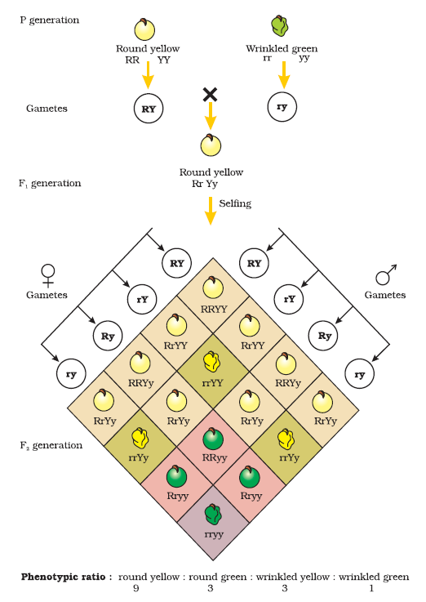
INHERITANCE OF TWO GENES
Dihybrid cross where two parents differed in two pairs of contrasting traits:
seed colour and
seed shape
Genotypic Symbols
Y : dominant yellow seed colour
y : recessive green seed colour
R : Dominant round shaped seeds
r : Recessive wrinkled seed shape.
Results of a dihybrid cross:
Notes:
Mendel found that the seeds resulting from the crossing of the parents, had yellow coloured and round shaped seeds (F₁ generation).
Thus, yellow colour was dominant over green and round shape dominant over wrinkled.
These results were identical to those that he got when he made separate monohybrid crosses between yellow and green seeded plants and between round and wrinkled seeded plants.
Let us use the genotypic symbols Y for dominant yellow seed colour and y for recessive green seed colour, R for round shaped seeds and r for wrinkled seed shape. The genotype of the parents can then be written as RRYY and rryy. The cross between the two plants can be written down as in Figure 5.7 showing the genotypes of the parent plants. The gametes RY and ry unite on fertilisation to produce the F1 hybrid RrYy.
When Mendel self hybridised the F1 plants he found that 3/4th of F2 plants had yellow seeds and 1/4th had green. The yellow and green colour segregated in a 3:1 ratio. Round and wrinkled seed shape also segregated in a 3:1 ratio; just like in a monohybrid cross.

Slide 34
Law of Independent Assortment
Based upon Mendel’s observations on dihybrid crosses, he proposed Law of Independent Assortment.
Mendel’s Law of Independent Assortment states that
‘when two pairs of traits are combined in a hybrid, segregation of one pair of characters is independent of the other pair of characters’.
Notes:
Based upon Mendel’s observations on dihybrid crosses (crosses between plants differing in two traits), he proposed a second set of generalisations called Mendel’s Law of Independent Assortment.
The law states that
‘when two pairs of traits are combined in a hybrid, segregation of one pair of characters is independent of the other pair of characters’.
when two or more characteristics are inherited, individual hereditary factors assort independently during gamete production, giving different traits an equal opportunity of occurring together.

Slide 35
Question: Two pea plants one with round yellow seeds (RRYY) and another with 3 wrinkled green (rryy) seeds produce F₁ progeny that have round, yellow (RrYy) seeds. When F₁ plants are self-pollinated, which new combination of characters is expected in F₂ progeny? How many seeds with these new combinations of characters will be produced when a total 160 seeds are produced in F₂ generation? Explain with reason.
Answer:
As shown in the following tabular representation of 160 possible pea seeds in the F₂ generation, total number of new combinations of characters are as follows;
Round green : 30
Wrinkled yellow : 30
New combinations are produced due to the independent assortment of traits i.e. independent inheritance of traits by segregation of characters without depending on other characters.
 | Parental combination/trait/observable feature/characters | New combination/observable feature/trait/characters |  | Parental combination/observable feature/trait/characters | Total number of pea seeds in F₂ generation
Phenotypic Ratio | Round yellow | Round green | Wrinkled yellow | Wrinkled green | Total number of pea plants in F₂ genertion
 | 9 | 3 | 3 | 1 | 9 + 3 + 3 + 1 = 16
Number of pea seeds in F₂ generation | 90 | 30 | 30 | 10 | 90 + 30 + 30 + 10 = 160
Notes:
Mendel found that the seeds resulting from the crossing of the parents, had yellow coloured and round shaped seeds (F₁ generation).
Thus, yellow colour was dominant over green and round shape dominant over wrinkled.
These results were identical to those that he got when he made separate monohybrid crosses between yellow and green seeded plants and between round and wrinkled seeded plants.
Let us use the genotypic symbols Y for dominant yellow seed colour and y for recessive green seed colour, R for round shaped seeds and r for wrinkled seed shape. The genotype of the parents can then be written as RRYY and rryy. The cross between the two plants can be written down as in Figure 5.7 showing the genotypes of the parent plants. The gametes RY and ry unite on fertilisation to produce the F1 hybrid RrYy.
When Mendel self hybridised the F1 plants he found that 3/4th of F2 plants had yellow seeds and 1/4th had green. The yellow and green colour segregated in a 3:1 ratio. Round and wrinkled seed shape also segregated in a 3:1 ratio; just like in a monohybrid cross.

Slide 36
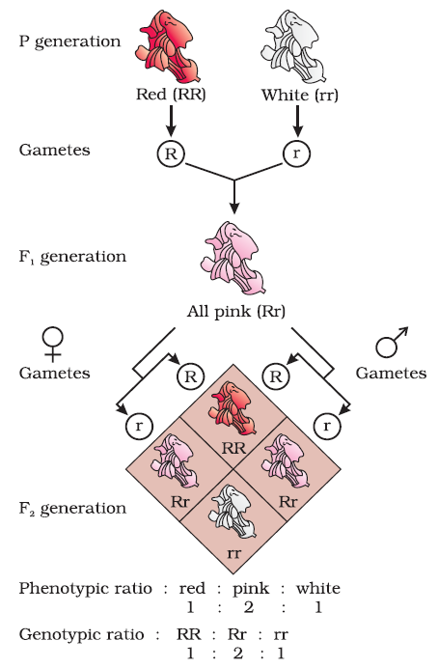
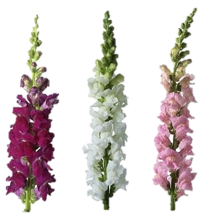
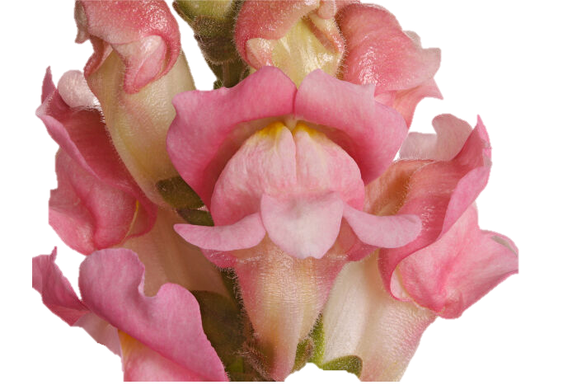
Incomplete Dominance: Dominant allele is not completely dominant over recessive allele
Rr
Monohybrid cross in the Snapdragon (Antirrhinum sp.) plant result in one allele incompletely dominant over the other allele i.e. R is not completely dominant over r
Phenotype of F₁ did not resemble either of the two parents and was in between the two parents.
Phenotypic ratio had changed from the 3:1 obtained by Mendel in F₂ generation
Notes:
When experiments on peas were repeated using other traits in other plants, it was found that sometimes the F1 had a phenotype that did not resemble either of the two parents and was in between(intermediate) the two. The inheritance of flower colour in the dog flower (snapdragon or Antirrhinum sp.- A. manjus) is a good example to understand incomplete dominance.
In a cross between true-breeding red-flowered (RR) and true breeding white-flowered plants (rr), the F1 (Rr) was pink. When the F1 was self-pollinated the F2 resulted in the following ratio 1 (RR) Red: 2 (Rr) Pink : 1 (rr) White. Here the genotype ratios were exactly as we would expect in any mendelian monohybrid cross, but the phenotype ratios had changed from the 3:1 dominant : recessive ratio. What happened was that R was not completely dominant over r and this made it possible to distinguish Rr as pink from RR (red) and rr (white) .
Every gene contains the information to express a particular trait.
In a diploid organism, there are two copies of each gene, i.e., as a pair of alleles. Now, these two alleles need not always be identical, as in a heterozygote. One of them may be different due to some changes that it has undergone which modifies the information that particular allele contains.

Slide 37
Question: A snapdragon plant with red flowers was crossed with another such plant with white flowers. The F₁ progeny obtained had pink flowers. Explain, in brief, the inheritance pattern seen in offsprings of F₁ generation?
A question from sample paper 2020-2021
Answer:
The inheritance is incomplete dominance. In this, a new intermediate phenotype between the two original phenotypes is obtained. One allele for a specific trait is not completely expressed over the other allele for the same trait.
Notes:
When experiments on peas were repeated using other traits in other plants, it was found that sometimes the F1 had a phenotype that did not resemble either of the two parents and was in between(intermediate) the two. The inheritance of flower colour in the dog flower (snapdragon or Antirrhinum sp.- A. manjus) is a good example to understand incomplete dominance.
In a cross between true-breeding red-flowered (RR) and true breeding white-flowered plants (rr), the F1 (Rr) was pink. When the F1 was self-pollinated the F2 resulted in the following ratio 1 (RR) Red: 2 (Rr) Pink : 1 (rr) White. Here the genotype ratios were exactly as we would expect in any mendelian monohybrid cross, but the phenotype ratios had changed from the 3:1 dominant : recessive ratio. What happened was that R was not completely dominant over r and this made it possible to distinguish Rr as pink from RR (red) and rr (white) .
Every gene contains the information to express a particular trait.
In a diploid organism, there are two copies of each gene, i.e., as a pair of alleles. Now, these two alleles need not always be identical, as in a heterozygote. One of them may be different due to some changes that it has undergone which modifies the information that particular allele contains.

Slide 38
Genetic Basis of Blood Groups in Human Population
Multiple allelism is existence of more than two alleles for a gene. For example; The gene (I) of ABO blood groups has three alleles I^{A}, I^{B} and i.
Human (diploid organism) possesses any two of the three I gene alleles - I^{A}, I^{B} and i.
I^{A} and I^{B} are completely dominant over i (because i does not produce any sugar)
Co-dominance is expression of traits of both the alleles of a gene when present together. Example; Codominance of gene I^{A}I^{B} of AB blood group
Allele from Parent 1 | Allele from Parent 2 | Genotype of offspring | Blood types of offspring | Remarks
I^{A} | I^{A}
I^{A} | I^{B}
I^{A} | i
I^{B} | I^{A}
I^{B} | I^{B}
I^{B} | i
I^{A} | i
i | i
I^{A}I^{A}
A
Expression of both the homozygous alleles
I^{A}I^{B}
AB
Co-dominance
I^{A}i
A
I^{A} is dominant over i
I^{A}I^{B}
AB
Co-dominance
I^{B}I^{B}
B
Expression of both the homozygous alleles
I^{B}i
B
I^{B} is dominant over i
I^{A}i
A
I^{A} is dominant over i
ii
O
i doesn’t produce any sugar
Notes:
Since there are three different alleles, there are six different combinations of these three alleles that are possible a total of six different genotypes of the human ABO blood types

Slide 39
A single gene product may produce more than one effect
Occasionally, a single gene product may produce more than one effect.
For example, starch synthesis in pea seeds is controlled by one gene (B) with two alleles (B and b).
Alleles (of the gene for starch synthesis) | Starch synthesis | Characteristics of mature seed
BB (Homozygote dominant) | Effective synthesis of starch | Round shaped, large starch grains
Bb (Heterozygotes) | Average synthesis of starch | Round shaped, Intermediate sized starch grains Alleles (Bb) show incomplete dominance
bb (Homozygote recessive) | Less efficient synthesis of starch | Wrinkled shaped, smaller starch grain
Pleiotropism/pleiotropy is a phenomenon when single gene produce more than one effect (the multiple effect of a gene) [Single gene exhibits multiple phenotypic expression]
Notes:
Starch is synthesised effectively by BB homozygotes and therefore, large starch grains are produced. In contrast, bb homozygotes have lesser efficiency in starch synthesis and produce smaller starch grains.
After maturation of the seeds, BB seeds are round and the bb seeds are wrinkled.
Heterozygotes produce round seeds, and so B seems to be the dominant allele. But, the starch grains produced are of intermediate size in Bb seeds. So if starch grain size is considered as the phenotype, then from this angle, the alleles show incomplete dominance.

Slide 40
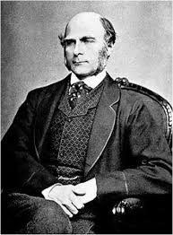
Quantitative /polygenic /multiple factor inheritance
Galton (1883) found that at least in some instances the same character can be determined by more than one gene and are inheritable.
Galton’s postulate gained experimental support.
Traits that have been found to be determined by many genes are;
Height in plants and human
yield of crops (size, shape and number of seeds and fruits per plant),
intelligence in human beings
milk yield in animals
human skin colour
Each gene has a certain amount of effect, and the more the number of dominant genes, the greater expression of the character.
Inheritance in which traits are controlled by more than one genes is called quantitative inheritance/polygenic inheritance/multiple factor inheritance.
Traits controlled by more than one genes are known as polygenic traits.
Phenotype reflects contribution of each allele and is also contributed by the influence of environment.
Notes:
Galton in 1883 suggested that many instances of continuous variation are heritable.
He was impressed by the fact that taller human beings generally produce taller children.
He suggested that characters such as height and mental capabilities in humans are heritable although these show a continuous range of variation in a population.
Galton’s postulate gained experimental support when it was found that at least in some instances the same character can be determined by more than one gene, each with the same but cumulative phenotypic effect. Quantitative characters like plant height, yield of crops (size, shape and number of seeds and fruits per plant), intelligence in human beings and milk yield in animals have been found to be determined by many genes and their effects have been found to be cumulative.
Each gene has a certain amount of effect, and the more the number of dominant genes, the greater expression of the character.. Though polygenic traits can be easily influenced by environment, these are generally controlled by three or more genes with phenotype reflecting the contribution of each allele (Quantitative).
Let us discuss the polygenic trait by studying the inheritance of human skin colour. There are no contrasting phenotypes for this trait. Let us assume that this trait is controlled by three genes A, B, and C. in this cross, there is a mating between dark-skinned and fair-skinned human beings and then the intermediate skin coloured individuals expected at F1 are mated to obtain F2 progeny.
Polygenic
If the F2 data are plotted graphically, a bell-shaped curve results.
In this example, we have assumed the involvement of three gene pairs, However if higher number of genes are involved in determining a phenotype, greater variety would be expected in F2generation.
Other examples that can be studied are the kernel colour in wheat and inheritance of cob length in maize. It is generally believed that during evolution there was duplication of chromosome or chromosome parts thereby leading to multiple copies of the same gene. A large number of characters are controlled by polygenes in which alleles contribute additively to a phenotype. This results in polygenic inheritance.

Slide 41
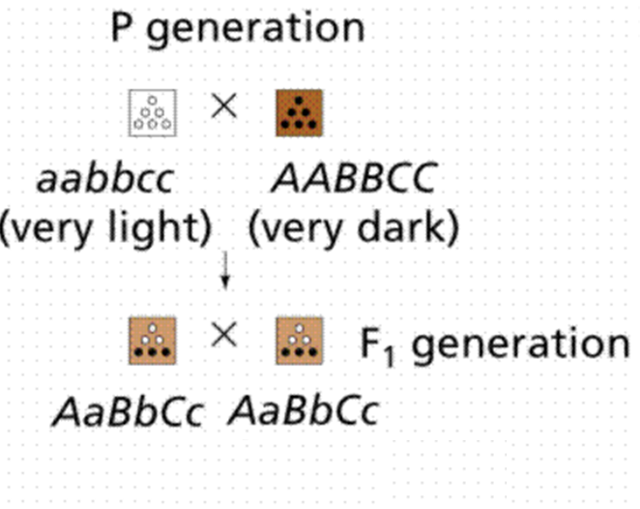
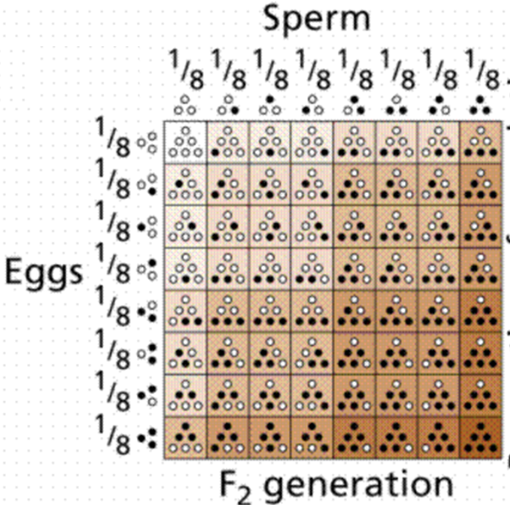
Polygenic inheritance of human skin colour
Let us assume that human skin colour is controlled by three genes A, B, and C.
If there is a mating between dark-skinned (AABBCC) and fair-skinned (aabbcc) human beings, then the intermediate skin coloured individuals are expected at F₁.
F₁ individuals are mated to obtain F₂ progeny.
Notes:
Galton in 1883 suggested that many instances of continuous variation are heritable.
He was impressed by the fact that taller human beings generally produce taller children.
He suggested that characters such as height and mental capabilities in humans are heritable although these show a continuous range of variation in a population.
Galton’s postulate gained experimental support when it was found that at least in some instances the same character can be determined by more than one gene, each with the same but cumulative phenotypic effect. Quantitative characters like plant height, yield of crops (size, shape and number of seeds and fruits per plant), intelligence in human beings and milk yield in animals have been found to be determined by many genes and their effects have been found to be cumulative.
Each gene has a certain amount of effect, and the more the number of dominant genes, the greater expression of the character.. Though polygenic traits can be easily influenced by environment, these are generally controlled by three or more genes with phenotype reflecting the contribution of each allele (Quantitative).
Let us discuss the polygenic trait by studying the inheritance of human skin colour. There are no contrasting phenotypes for this trait. Let us assume that this trait is controlled by three genes A, B, and C. in this cross, there is a mating between dark-skinned and fair-skinned human beings and then the intermediate skin coloured individuals expected at F1 are mated to obtain F2 progeny.
Polygenic
If the F2 data are plotted graphically, a bell-shaped curve results.
In this example, we have assumed the involvement of three gene pairs, However if higher number of genes are involved in determining a phenotype, greater variety would be expected in F2generation.
Other examples that can be studied are the kernel colour in wheat and inheritance of cob length in maize. It is generally believed that during evolution there was duplication of chromosome or chromosome parts thereby leading to multiple copies of the same gene. A large number of characters are controlled by polygenes in which alleles contribute additively to a phenotype. This results in polygenic inheritance.

Slide 42
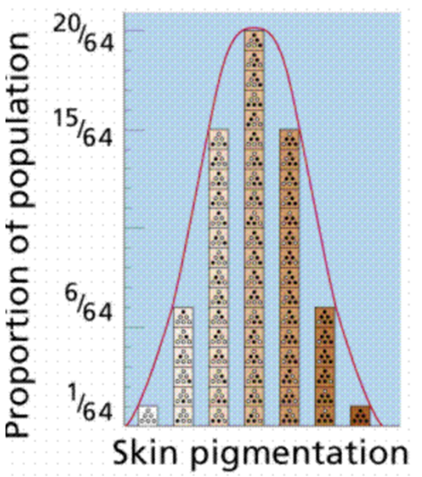
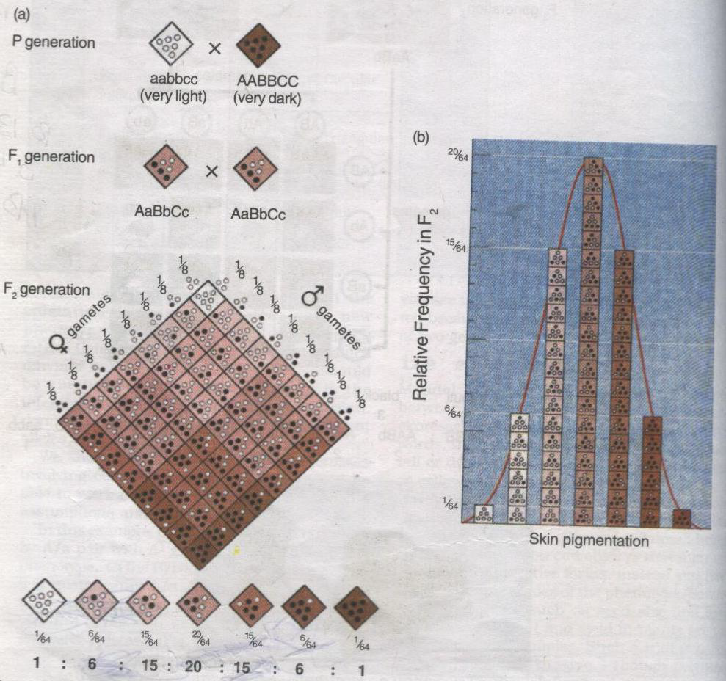
A cross depicting the inheritance of human skin colour controlled by polygenes.
The relative frequency of F₂ progeny in a polygenic cross is plotted against the extent of phenotypic expression – a typical bell shaped curve is seen.
It is clear that:-
Few individuals fall into parental categories
The expression level of the phenotype is dependent upon the number of contributive alleles and is hence more quantitative.
Notes:
Galton in 1883 suggested that many instances of continuous variation are heritable. He was impressed by the fact that taller human beings generally produce taller children. He suggested that characters such as height and mental capabilities in humans are heritable although these show a continuous range of variation in a population. Galton’s postulate gained experimental support when it was found that at least in some instances the same character can be determined by more than one gene, each with the same but cumulative phenotypic effect Quantitative characters like plant height, yield of crops (size, shape and number of seeds and fruits per plant), intelligence in human beings and milk yield in animals have been found to be determined by many genes and their effects have been found to be cumulative. Each gene has a certain amount of effect, and the more the number of dominant genes, the greater expression of the character. Quantitative inheritance is also known as polygenic inheritance or multiple factor inheritance. Though polygenic traits can be easily influenced by environment, these are generally controlled by three or more genes with phenotype reflecting the contribution of each allele (Quantitative). Let us discuss the polygenic trait by studying the inheritance of human skin colour. There are no contrasting phenotypes for this trait. Let us assume that this trait is controlled by three genes A, B, and C. in this cross, there is a mating between dark-skinned and fair-skinned human beings and then the intermediate skin coloured individuals expected at F1 are mated to obtain F2 progeny.
Polygenic
If the F2 data are plotted graphically, a bell-shaped curve results.
In this example, we have assumed the involvement of three gene pairs, However if higher number of genes are involved in determining a phenotype, greater variety would be expected in F2generation.
Other examples that can be studied are the kernel colour in wheat and inheritance of cob length in maize. It is generally believed that during evolution there was duplication of chromosome or chromosome parts thereby leading to multiple copies of the same gene. A large number of characters are controlled by polygenes in which alleles contribute additively to a phenotype. This results in polygenic inheritance.

Slide 43
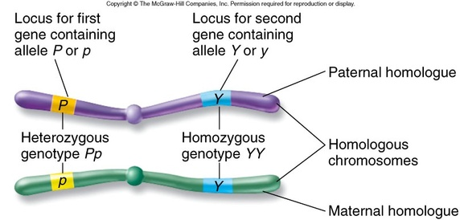
Chromosomal Theory of Inheritance
1865: Gregor Johan Mendel’s work on the inheritance of characters published
1900: Rediscovered Mendel’s work by De Vries, Correns and Von Tschermak, Observed structures in the nucleus that appeared to double and divide just before each cell division and later named chromosomes (Greek; Khroma meaning colour, soma meaning body -appeared coloured bodies, when stained and observed under microscope).
1902: Walter Sutton and Theodore Boveri proposed chromosomal theory of inheritance separately
1910: Thomas Hunt Morgan and his colleagues verified chromosomal theory of inheritance and studied Linkage and Recombination using tiny fruit files (Drosophila melanogaster)
Gregor Johan Mendel | Chromosomal theory of Theodore Boveri and Walter Sutton
Factors (alleles) are in pairs
Factors separate during gamete formation
Alleles of factor assort independently
Genes on homologous chromosome occurs in pairs
Chromosome of the homologous pair separate during gamete formation
Homologous chromosomes assort themselves independently

Slide 44
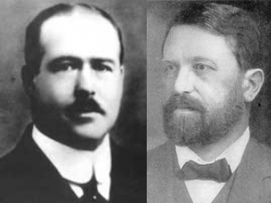
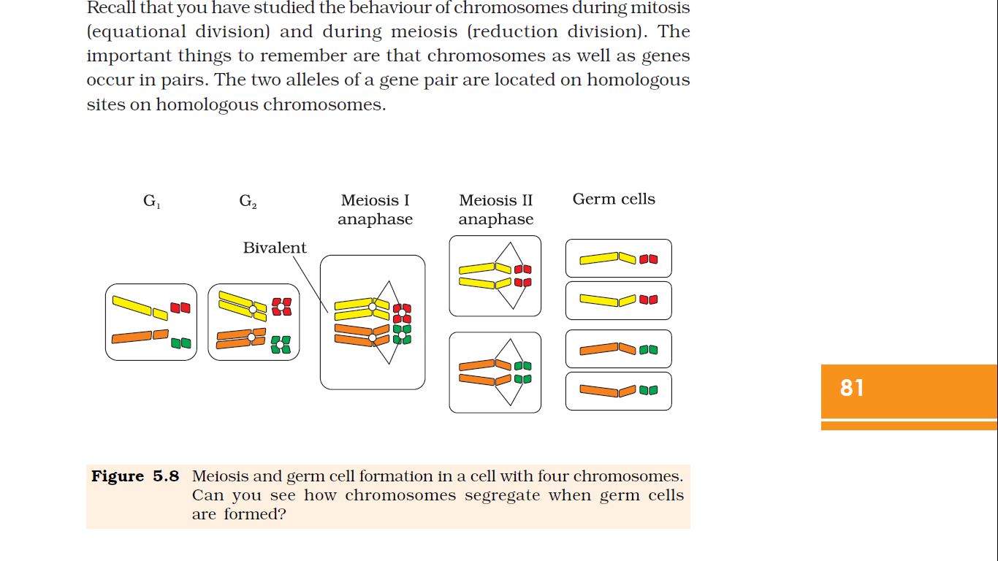
Walter Sutton and Theodore Boveri independently studied chromosome movement to explain Mendel’s laws and proposed Chromosomal Theory of Inheritance
Meiosis: Germ cell formation in a cell with four chromosomes.
Walter Sutton (left) and Theodore Boveri (right)
Notes:
Walter Sutton and Theodore Boveri noted that the behaviour of chromosomes was parallel to the behaviour of genes and used chromosome movement to explain Mendel’s laws.
Recall that you have studied the behaviour of chromosomes during mitosis (equational division) and during meiosis (reduction division). The important things to remember are that chromosomes as well as genes occur in pairs. The two alleles of a gene pair are located on homologous sites on homologous chromosomes.

Slide 45
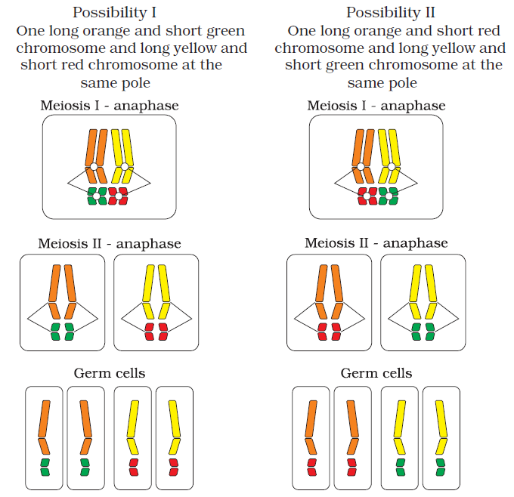
Independent assortment of chromosomes
During Anaphase of meiosis I, the two chromosome pairs can align at the metaphase plate independently of each other.

Slide 46
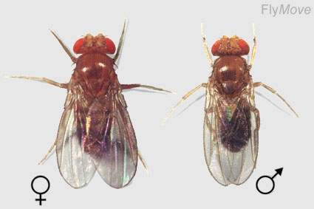
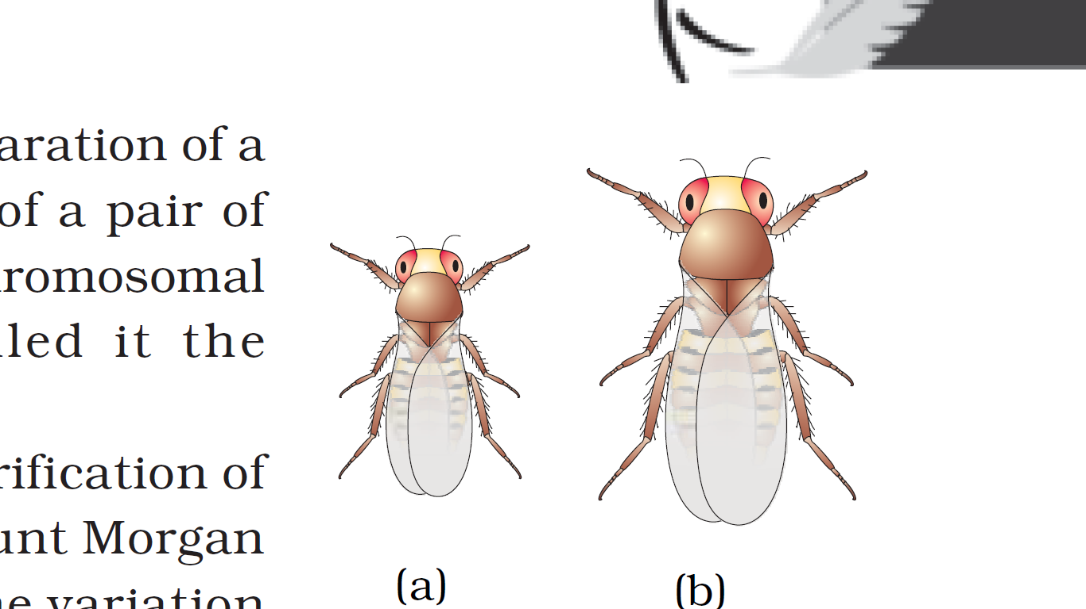
Thomas Hunt Morgan and his colleagues worked with the tiny fruit files (Drosophila melanogaster) which were found very suitable for such studies.
grows on simple synthetic medium.
Complete their life cycle in about two weeks
A single mating could produce a large number of progeny flies.
Clear differentiation of male and female flies
It has many types of hereditary variations that can be seen with low power microscopes.
Drosophila melanogaster
Notes:
Experimental verification of the chromosomal theory of inheritance by Thomas Hunt Morgan and his colleagues, led to discovering the basis for the variation that sexual reproduction produced.
Morgan worked with the tiny fruit files, Drosophila melanogaster , which were found very suitable for such studies.
They could be grown on simple synthetic medium in the laboratory.
They complete their life cycle in about two weeks
A single mating could produce a large number of progeny flies.
There was a clear differentiation of the sexes – the male and female flies are easily distinguisable.
It has many types of hereditary variations that can be seen with low power microscopes.

Slide 47
Linkage and Recombination
In 1910, Thomoas Hunt Morgan and his colleagues worked on fruit flies (Drosophila malanogaster).
Carried out dihybrid cross with sex-linked genes.
They crossed yellow-bodied, white eyed females to brown-bodied, red-eyed males (Wild type) and inter crossed their F₁ progeny
Observation and result of T.H Morgan and his colleagues;
Two genes did not segregate independently.
F₂ ratio deviated very significantly from the 9:3:3:1 ratio.
Observed characteristic features of chromosomes;
very tightly linked (showed very low recombination)
loosely linked (showed higher recombination).
Notes:
Wild type: strain, gene or characteristics which prevails among individuals in natural condition as distinct from an atypical mutant
Morgan carried out several dihybrid crosses in Drosophila to study genes that were sex-linked.
The crosses were similar to the dihybrid crosses carried out by Mendel in peas.
For example Morgan hybridised yellow-bodied, white eyed females to brown-bodied, red-eyed males and inter crossed their F1 progeny.
He observed that the two genes did not segregate independently of each other and the F₂ ratio deviated very significantly from the 9:3:3:1 ratio (expected when the two genes are independent).
He observed that the two genes did not segregate independently of each other and the F₂ ratio deviated very significantly from the 9:3:3:1 ratio (expected when the two genes are independent).

Slide 48
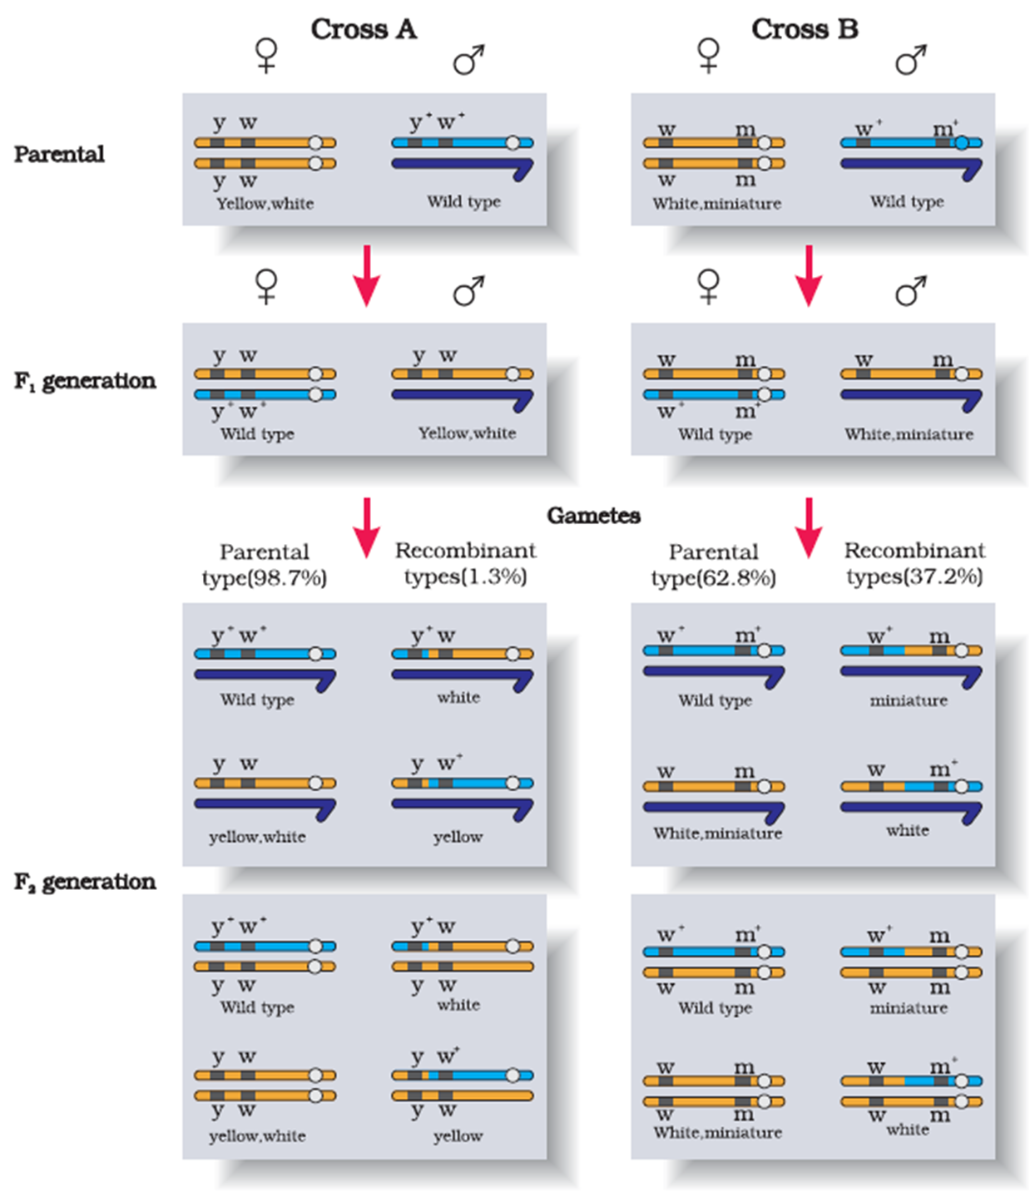
Figure: Results of two dihybrid crosses conducted by Morgan and his colleagues using Drosophila malanogaster
Cross A shows crossing between gene y and w;
Cross B shows crossing between genes w and m.
Dominant wild type alleles are represented with (+) sign in superscript
Note:
The strength of linkage between y and w is higher than w and m.
Y and w eye showed 1.3 % recombination
White and miniature wing showed 37.2 % recombination frequency
Notes:
Today genetic maps are extensively used as a starting point in the sequencing of whole genomes as was done in the case of the Human Genome Sequencing Project.

Slide 49
Morgan and et. al, 1910
If two genes in a dihybrid cross are located on same chromosome, the proportion of parental gene combination in the progeny is much higher than the non-parental or recombination of genes.
Proportion of recombinants varies, even if the two genes are present on same chromosome.
Stronger the linkage between two genes lower the frequency of recombination and vice versa.
Notes:
Morgan and his group knew that the genes were located on the X chromosome
They observed that when the two genes in a dihybrid cross were situated on the same chromosome, the proportion of parental gene combinations were much higher than the non-parental type.
Morgan attributed this due to the physical association or linkage of the two genes and coined the term linkage to describe this physical association of genes on a chromosome and the term recombination to describe the generation of non-parental gene combinations.

Slide 50
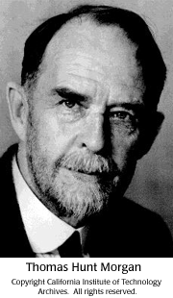
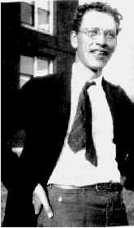
Alfred Sturtevant studied frequency of recombination and gene mapping
T.H Morgan’s student Alfred Sturtevant used the frequency of recombination between gene pairs on the same chromosome as a measure of the distance between genes and ‘mapped’ their position on the chromosome.
Recombination frequency = Number of recombinant/Total population X 100
Alfred Sturtevant
Notes:
Morgan and his group also found that even when genes were grouped on the same chromosome, some genes were
very tightly linked (showed very low recombination) while
others were loosely linked (showed higher recombination).
He found that the genes white and yellow were very tightly linked and showed only 1.3 per cent recombination while white and miniature wing showed 37.2 per cent recombination.
Recombination frequency: Number of recombinant/Total population*100

Slide 51

Salient features of Morgan's theory of Chromosomal Linkage
Linked genes occur on the same chromosome
Parental combination is maintained except for crossing overs
Strength of linkage of genes on homologous chromosome is inversely proportional to recombination
Frequency of crossing over is directly proportional to the distance between them
Strength of linkage $α$ 1
Recombination
Frequency of crossing over $α$ Distance between them

Slide 52
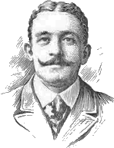
Chromosomal pattern based Sex determination in animals
Henking (1891) could trace a specific nuclear structure all through spermatogenesis in a few insects
He observed that 50 per cent of the sperm received the nuclear structure after spermatogenesis, whereas the other 50 per cent sperm did not receive it.
Henking gave a name to this structure as the X body
Further investigations by other scientists led to the conclusion that the ‘X body’ of Henking was in fact a chromosome and that is why it was given the name X-chromosome.
It was also observed that in a large number of insects the mechanism of sex determination is of the XO type, i.e., all eggs bear an additional X-chromosome besides the other chromosomes (autosomes).
On the other hand, some of the sperms bear the X-chromosome whereas some do not. Eggs fertilised by sperm having and X-chromosome become females and, those fertilised by sperms that do not have an X-chromosome become males.

Slide 53
Sex determination
Types of sex chromosomes | Examples | Female |  | Male
 |  | sex chromosome | Types of gamete (s) produced | sex chromosome | Nature of gamete
Fruit fly,
Mammals (say human)
Most insects
Heterogamety
(Gametes have either X or Y chromosomes)
XX – XY type
XX
Homogamety
(All the ova have X chromosome)
XY
Grass hopper,
Round worms
Some insects
Heterogamety
(Every sperms have either X or no chromosomes)
XX – XO type
XX
Homogamety
(All gametes have X chromosome)
XO
Heterogamety
(Eggs have either Z or W chromosomes)
Homogamety
(All sperms have Z chromosome)
Birds
Some reptiles
ZZ – ZW type
ZW
ZZ
Notes:
The initial clue about the genetic/ chromosomal mechanism of sex determination can be traced back to some of the experiments carried out in insects.
In fact, the cytological observations made in a number of insects led to the development of the concept of genetic/chromosomal basis of sex-determination.
Henking (1891) could trace a specific nuclear structure all through spermatogenesis in a few insects, and it was also observed by him that 50 per cent of the sperm received this structure after spermatogenesis, whereas the other 50 per cent sperm did not receive it. Henking gave a name to this structure as the X body but he could not explain its significance.
Further investigations by other scientists led to the conclusion that the ‘X body’ of Henking was in fact a chromosome and that is why it was given the name X-chromosome.
It was also observed that in a large number of insects The mechanism of sex determination is of the XO type, i.e., all eggs bear an additional X-chromosome besides the other chromosomes (autosomes).
On the other hand, some of the sperms bear the X-chromosome whereas some do not.
Eggs fertilised by sperm having an X-chromosome become females and, those fertilised by sperms that do not have an X-chromosome become males.
Due to the involvement of the X-chromosome in the determination of sex, it was designated to be the sex chromosome, and the rest of the chromosomes were named as autosomes.
Grasshopper is an example of XO type of sex determination in which the males have only one X-choromosome besides the autosomes, whereas females have a pair of X-chromosomes.
These observations led to the investigation of a number of species to understand the mechanism of sex determination.
In a number of other insects and mammals including man, XY type of sex determination is seen where both male and female have same number of chromosomes.
Among the males an X-chromosome is present but its counter part is distinctly smaller and called the Y-chromosome.
Females, however, have a pair of X-chromosomes.
Both males and females bear same number of autosomes. Hence, the males have autosomes plus XY, while female have autosomes plus XX.
In human beings and in Drosophila the males have one X and one Y chromosome, whereas females have a pair of X chromosomes besides autosomes.
In the above description you have studied about two types of sex determining mechanisms, i.e., XO type and XY type.
But in both cases males produce two different types of gametes,
(a) either with or without X-chromosome or
(b) some gametes with X-chromosome and some with Y-chromosome.
Such types of sex determination mechanism is designated to be the example of male heterogamety. In some other organisms, e.g., birds a different mechanism of sex determination is observed.
In this case the total number of chromosome is same in both males and females. But two different types of gametes in terms of the sex chromosomes, are produced by females, i.e., female heterogamety.
In order to have a distinction with the mechanism of sex determination described earlier, the two different sex chromosomes of a female bird has been designated to be the Z and W chromosomes.
In these organisms the females have one Z and one W chromosome, whereas males have a pair of Z-chromosomes besides the autosomes.

Slide 54
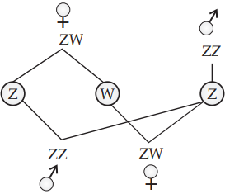
In birds, sex is determined as follow
🐓ZZ
♂
♀
ZW
Z
W
Female birds produce heterogametes i.e. female produces (Z) type and (W) type of gametes
Z
Z
🐓
ZZ
ZW
♂
♀

Slide 55
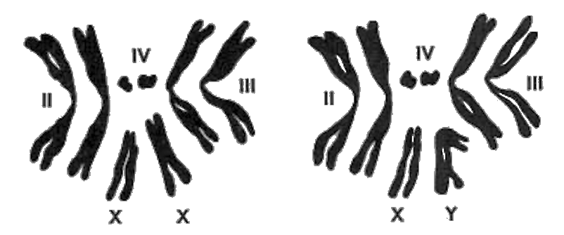
Chromosomes in Drosophila
In Drosophila melanogaster , there are 4 homologous pairs of chromosomes;
2 pairs of large autosomes, ( one slightly smaller than the other pair),
1 pair of very small autosomes, and
a pair of sex chromosomes.
♀
♂

Slide 56
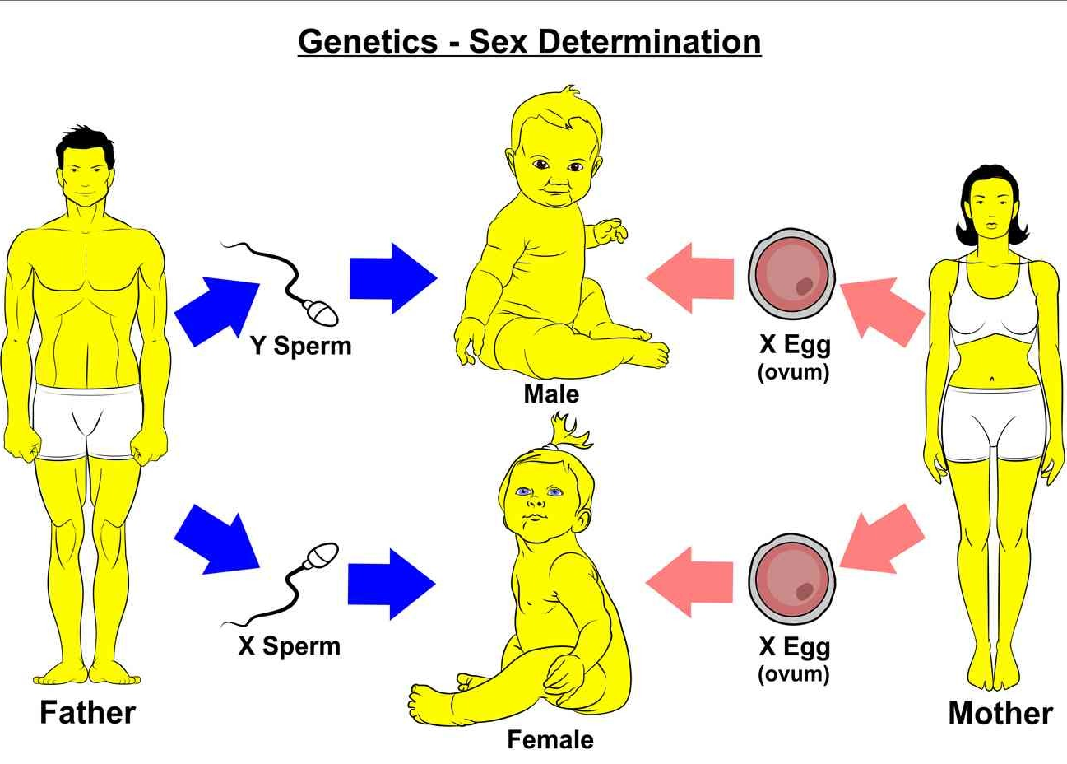
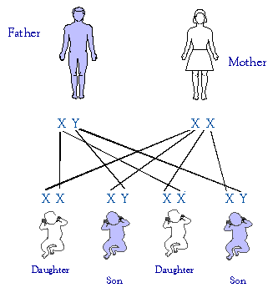
Sex determination in Humans
Notes:
The sex determining mechanism in case of humans is XY type.
Out of 23 pairs of chromosomes present, 22 pairs are exactly same in both males and females; these are the autosomes.
A pair of X-chromosomes are present in the female, whereas the presence of an X and Y chromosome are determinant of the male characteristic.
During spermatogenesis among males, two types of gametes are produced. 50 per cent of the total sperm produced carry the X-chromosome and the rest 50 per cent has Y-chromosome besides the autosomes.
Females, however, produce only one type of ovum with an X-chromosome.
There is an equal probability of fertilisation of the ovum with the sperm carrying either X or Y chromosome.
In case the ovum fertilises with a sperm carrying X-chromosome the zygote develops into a female (XX) and the fertilisation of ovum with Y-chromosome carrying sperm results into a male offspring.
Thus, it is evident that it is the genetic makeup of the sperm that determines the sex of the child.
It is also evident that in each pregnancy there is always 50 per cent probability of either a male or a female child.
It is unfortunate that in our society women are blamed for producing female children and have been ostracised and ill-treated because of this false notion.

Slide 57
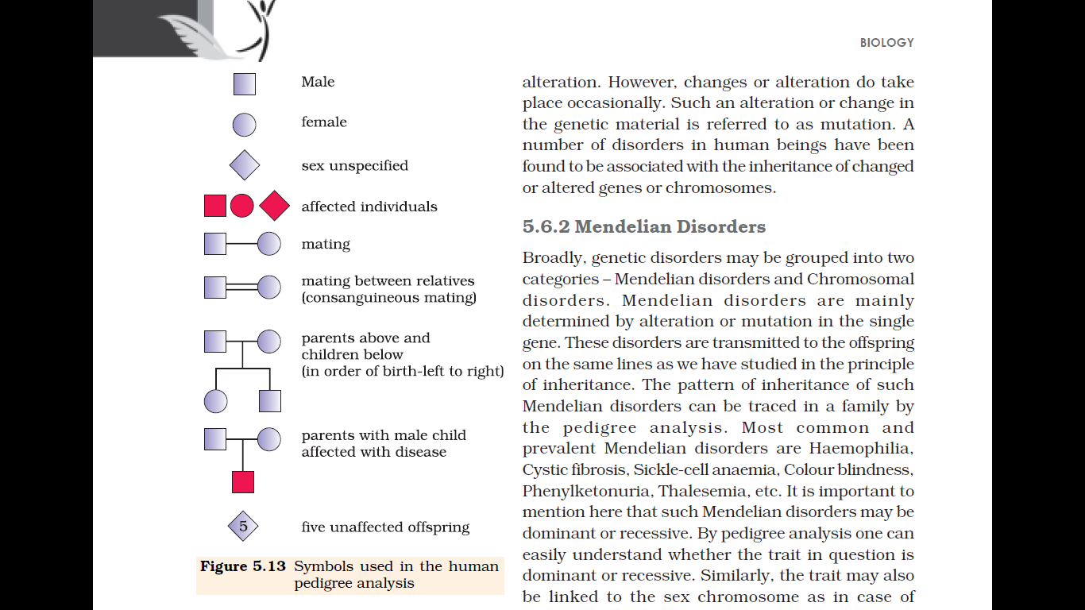
Pedigree analysis
Pedigree analysis is a system to analyse the distribution and movement of characters in the family tree.
Symbols used in Human Pedigree Analysis
Notes:
Pedigree analysis: the recorded ancestry or lineage of a person or family.

Slide 58
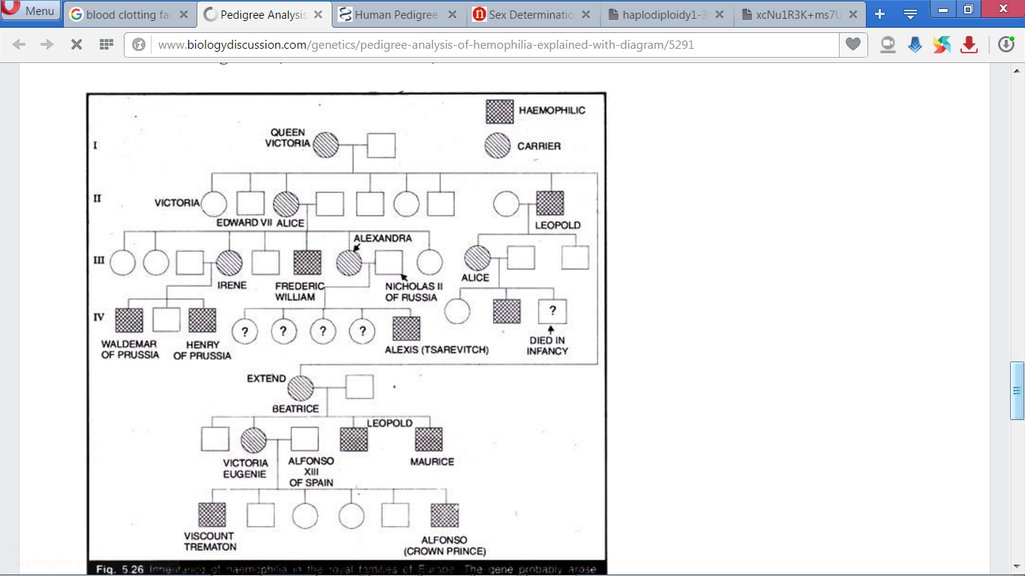
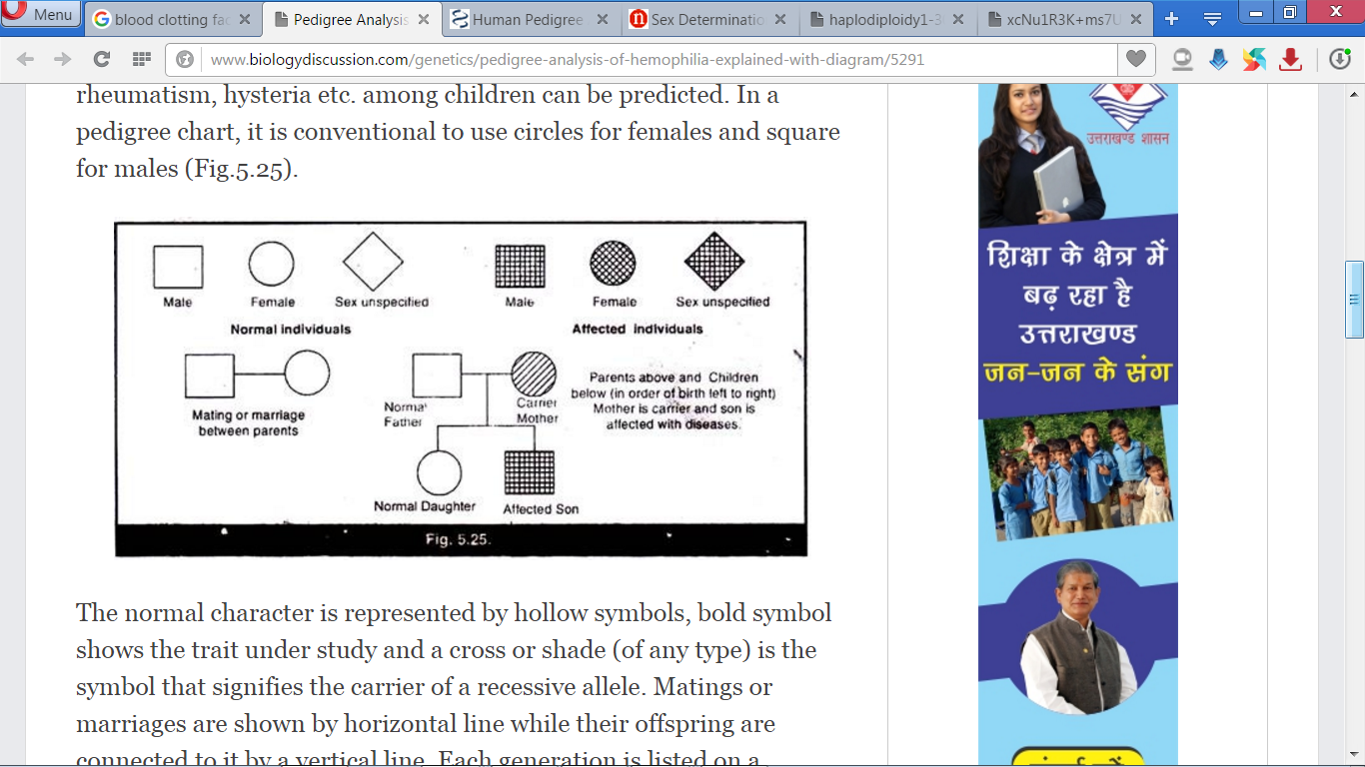
Queen Victoria of England (who ruled from 1837-1901) is believed to have been the carrier of hemophilia

Slide 59
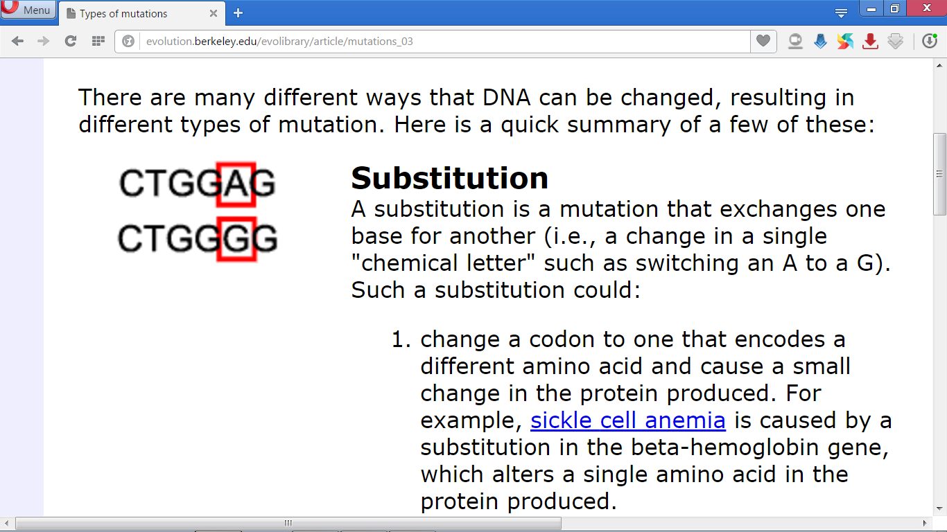
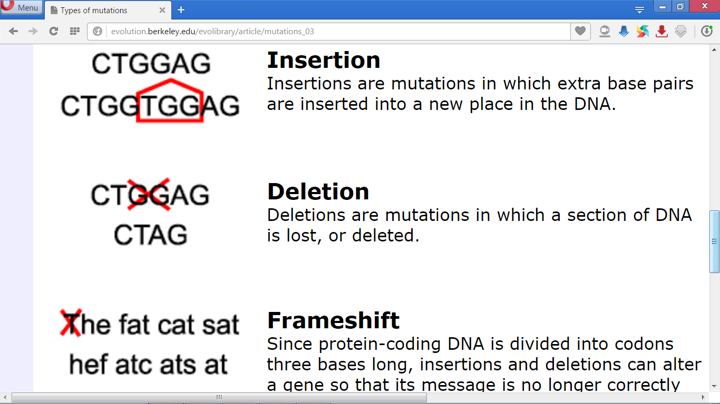
Mutation related Term to remember
Changes in DNA
Mutation is a phenomenon which results in alteration of DNA sequences and consequently results in changes in the genotype and phenotype of an organism.
Mutagens are chemical, biological or physical factors that induce mutations. Example; UV rays
Gene/Point mutation is due to change in a single base pair of DNA. Example; Sickle cell anemia (GAG→GUG i.e Glutamine by Valine).
Substitution, loss (deletions) or gain (insertion/duplication) of a segment of DNA also result in alteration in chromosomes.
Alteration of genotype
Changes phenotype

Slide 60
Genetic Disorders
Mendelian disorders
Determined by mutation in the gene(s).
Transmitted to the offspring.
Mendelian disorder can be
sex linked recessive disease i.e. gene for disease is present on X chromosome. Examples: Haemophilia, Colour blindness, etc.
autosome linked recessive disorder i.e mutant allele on autosome. Examples: Sickle cell anemia, Phenylketonuria, Thalassemia, etc.
Chromosomal disorders
Alteration in chromosomes results in abnormalities or aberrations i.e change in structure or number of chromosomes.
Exhibit absence/loss or gain/excess or abnormal arrangement of one or more chromosomes.
Arises due to non-disjunction of chromosomes during gamete formation as the maternal age increases.
Chromosomal disorder can lead to Aneuploidy (chromosome number is not an exact multiple of the haploid number of chromosome set)
Example: Klinefelter’s syndrome, Down’s syndrome (47) and Turner’s syndrome (45).

Slide 61
Ploidy of chromosomes
Aneuploidy
Number of chromosome is not an exact multiple of the haploid number of chromosome set.
Arises due to non-disjunction (juction) of chromosomes, during gamete formation as the maternal age increases.
Example: Down’s syndrome (47) and Turner’s syndrome (45).
Polyploidy
Number of chromosomes is the multiple of the number of chromosomes in a haploid set.
Example; haploid, diploid, triploid
Non-disjunction during anaphase

Slide 62
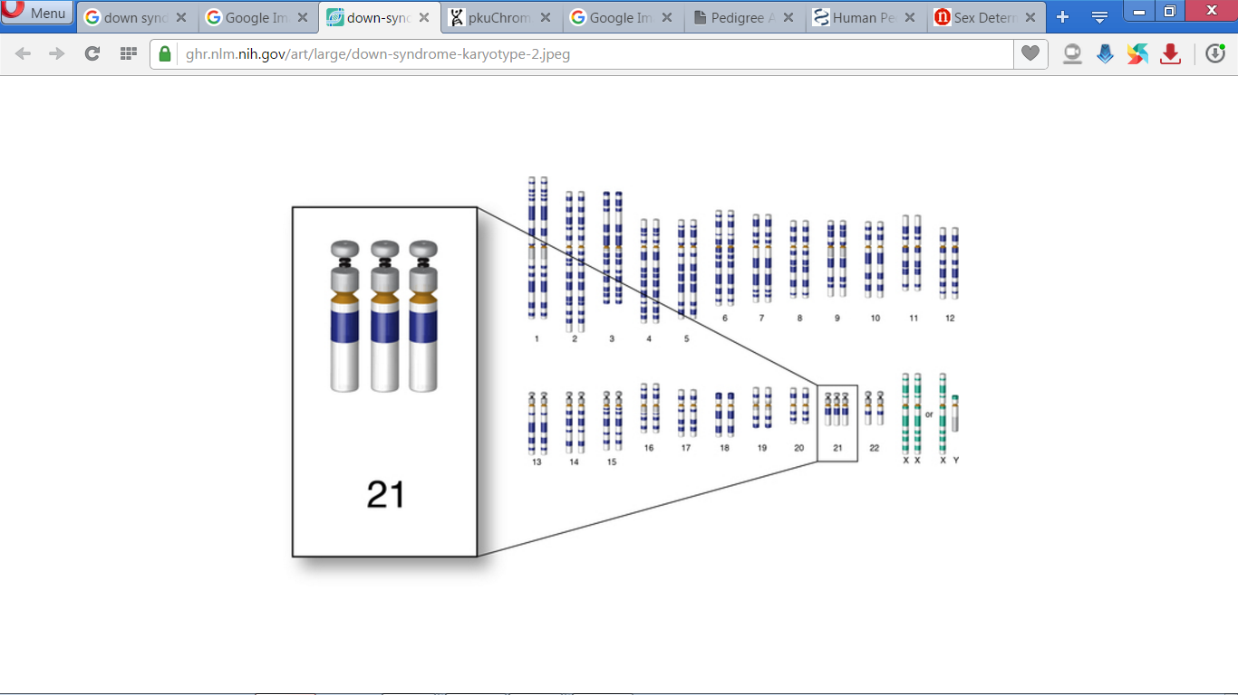
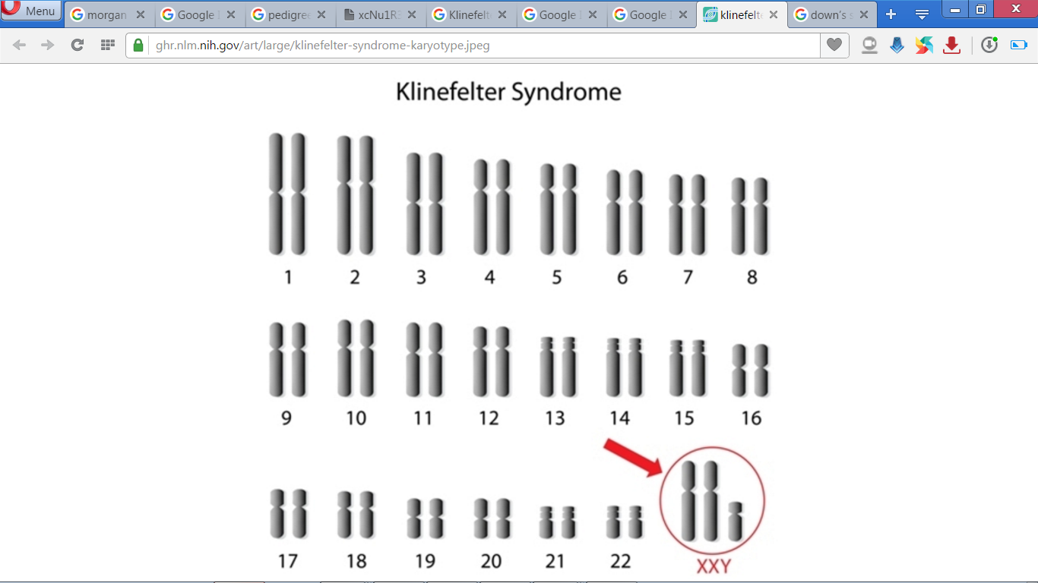
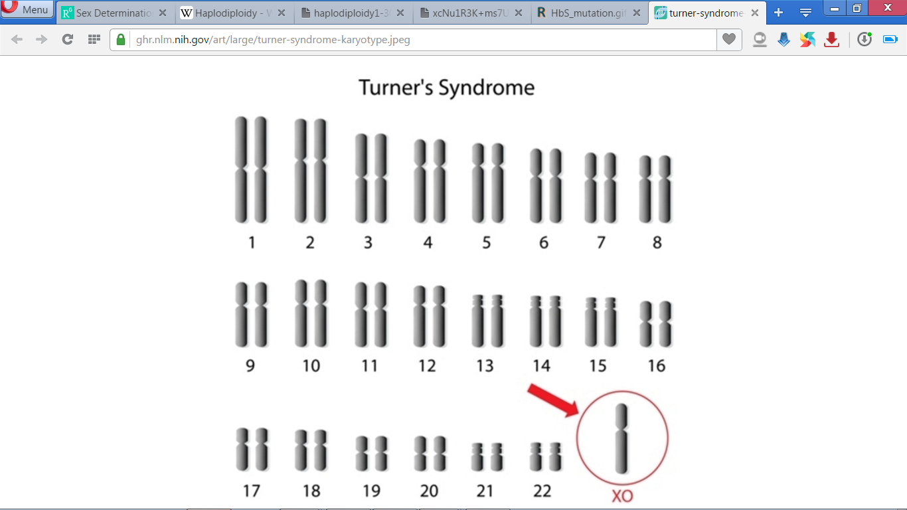
Chromosomal Disorders
Chromosomal Disorders | Cause of the disorder | Symptoms
Trisomy of 21st autosome
Fusion of ovum containing two 21st chromosomes (24) and normal sperm (23), the zygote (47) comes to possess three copies of 21st chromosome.
Short statured, small round mouth and head, palm is broad with characteristic palm crease, retarded development of physical, psychomotor and mental.
Down’s Syndrome¹
Trisomy of sex chromosome (XXY)
Fusion of an ovum containing two X-chromosomes with a Y-carrying sperm, XXY individual (47) appears
A male with underdeveloped breasts, sparse body hair, mentally retarded and sterile.
Klinefelter’s syndrome ²
Monosomy of X-Chromosome
Occurred by fusion of an ovum without X-chromosome and a sperm carrying X- chromosome, a zygote with XO appears.
A female with rudimentary ovaries, short stature, lack of secondary sexual characters, they are sterile.
Turner’s Syndrome ³
Down’s Syndrome
Klinefelter’s Syndrome
Turner’s Syndrome
¹ Named after English physician John Langdon Down
² Named after American endocrinologist Harry Klinefelter
³ Named after endocrinologist Henry Turner
Notes:
Aneuploidy: An abnormality involving a chromosome number that is not an exact multiple of the haploid number (one chromosome set is incomplete)
Polyploid cells and organisms are those containing more than two paired (homologous) sets of chromosomes. Most species whose cells have nuclei (Eukaryotes) are diploid, meaning they have two sets of chromosomes—one set inherited from each parent. However,polyploidy is found in some organisms and is especially common in plants.
Polyploidy may occur due to abnormal cell division, either during mitosis, or commonly during metaphase I in meiosis.
Polyploidy occurs in some animals, such as goldfish, salmon, and salamanders, but is especially common among ferns and floweringplants (see Hibiscus rosa-sinensis), including both wild and cultivated species. Wheat, for example, after millennia of hybridization and modification by humans, has strains that are diploid (two sets of chromosomes), tetraploid (four sets of chromosomes) with the common name of durum or macaroni wheat, and hexaploid (six sets of chromosomes) with the common name of bread wheat. Many agriculturally important plants of the genus Brassica are also tetraploids.
Polyploidy can be induced in plants and cell cultures by some chemicals: the best known is colchicine, which can result in chromosome doubling, though its use may have other less obvious consequences as well. Oryzalin will also double the existing chromosome content.

Slide 63
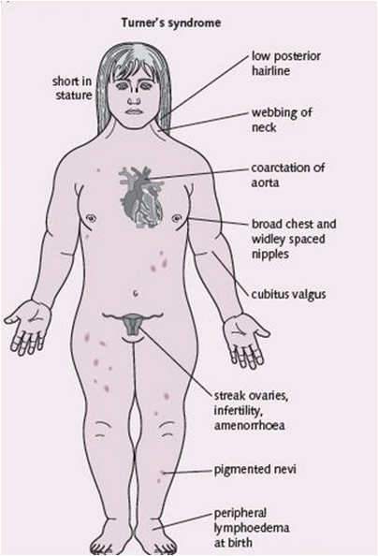
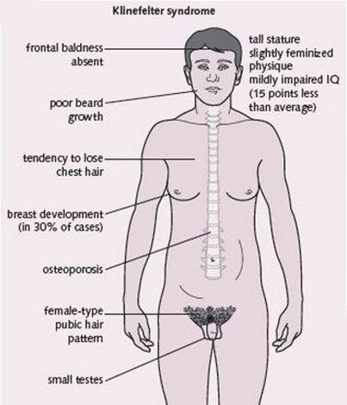
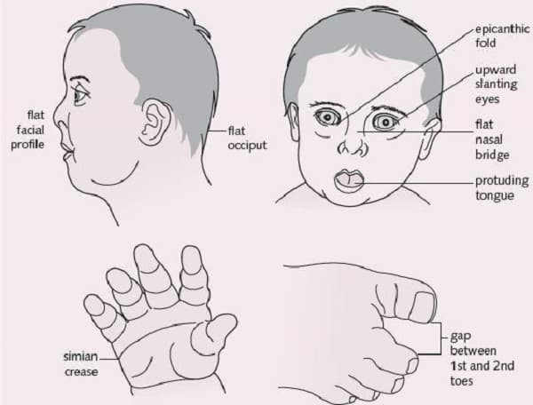
Down’s Syndrome
Notes:
Aneuploidy: An abnormality involving a chromosome number that is not an exact multiple of the haploid number (one chromosome set is incomplete)
Polyploid cells and organisms are those containing more than two paired (homologous) sets of chromosomes. Most species whose cells have nuclei (Eukaryotes) are diploid, meaning they have two sets of chromosomes—one set inherited from each parent. However,polyploidy is found in some organisms and is especially common in plants.
Polyploidy may occur due to abnormal cell division, either during mitosis, or commonly during metaphase I in meiosis.
Polyploidy occurs in some animals, such as goldfish, salmon, and salamanders, but is especially common among ferns and floweringplants (see Hibiscus rosa-sinensis), including both wild and cultivated species. Wheat, for example, after millennia of hybridization and modification by humans, has strains that are diploid (two sets of chromosomes), tetraploid (four sets of chromosomes) with the common name of durum or macaroni wheat, and hexaploid (six sets of chromosomes) with the common name of bread wheat. Many agriculturally important plants of the genus Brassica are also tetraploids.
Polyploidy can be induced in plants and cell cultures by some chemicals: the best known is colchicine, which can result in chromosome doubling, though its use may have other less obvious consequences as well. Oryzalin will also double the existing chromosome content.

Slide 64


Haemophilia
Haemophilia is a sex linked recessive disease i.e. gene for haemophilia is present on X chromosome
It is transmitted from unaffected carrier mother to some of the male progeny.
Haemophilia is a disorder in which a vital factor for clotting of blood is lacking. So clotting of blood is abnormally delayed and it can be fatal.
Bleeding can be checked by transfusion of the entire volume of blood or the clotting factor in concentrated form.
It is observed more in males because of presence of only one X chromosome as compared to two chromosomes of females.

Slide 65
Colour blindness (Color vision deficiency)
Colour blindness is a sex-linked recessive disorder i.e. gene for colour blindness is present on X chromosome.
It results in defect in either red or green cone of eye resulting in inability to distinguish between red and green colour.
It is observed more in males because of presence of only one X chromosome as compared to two chromosomes of females.
Notes:
Colour blindness is a sex-linked recessive disorder i.e. gene for colour blindness is present on X chromosome.
It results in defect in either red or green cone of eye resulting in inability to distinguish between red and green colour.
It is observed more in males (X^{C}Y) because of presence of only one X chromosome as compared to two chromosomes of females.
Sex-linked diseases are passed down through families through one of the X or Y chromosomes. X and Y are sex chromosomes.
Dominant inheritance occurs when an abnormal gene from one parent causes disease even though the matching gene from the other parent is normal. The abnormal gene dominates.
But in recessive inheritance, both matching genes must be abnormal to cause disease. If only one gene in the pair is abnormal, the disease does not occur or it is mild. Someone who has one abnormal gene (but no symptoms) is called a carrier. Carriers can pass abnormal genes to their children.
The term "sex-linked recessive" usually refers to X-linked recessive.
Information
X-linked recessive diseases usually occur in males. Males have only one X chromosome. A single recessive gene on that X chromosome will cause the disease.
The Y chromosome is the other half of the XY gene pair in the male. However, the Y chromosome doesn't contain most of the genes of the X chromosome. Because of that, it doesn't protect the male. Diseases such as hemophilia and Duchenne muscular dystrophyoccur from a recessive gene on the X chromosome.
The retina contains two types of photoreceptors, rods and cones. The rods are more numerous, some 120 million, and are more sensitive than the cones. However, they are not sensitive to color. The 6 to 7 million cones provide the eye's color sensitivity and they are much more concentrated in the central yellow spot known as the macula. In the center of that region is the " fovea centralis ", a 0.3 mm diameter rod-free area with very thin, densely packed cones.

Slide 66

Expected previous Knowledge
Hemoglobin is the protein in red blood cells that carries oxygen.

Slide 67



Sickle cell anemia
Sickle cell anemia is an autosome linked recessive trait.
It is due to a mutant allele on chromosome 11 (autosome)
This mutation causes change of glutamine (GAG) to valine (GUG) at the sixth position of β-chain of haemoglobin.
The patient has sickle shaped RBCs with defective haemoglobin.
They are destroyed more rapidly than normal RBCs.
Normal RBCs
Sickle shaped RBCs
Microscopic view
Notes:
(fibrinogen, prothrombin, tissue thromboplastin)

Slide 68
Thalassemia
Thalassemia is an autosome linked recessive disease.
Thalassemia is a blood disorder passed down through families (inherited) in which the body makes an abnormal form of hemoglobin.
The disorder results in destruction of large number of blood cells, which leads to anemia* (Low RBC count).
*A condition in which there is a deficiency of red cells or of haemoglobin in the blood.
Notes:
Thalassemia is a blood disorder passed down through families (inherited) in which the body makes an abnormal form of hemoglobin. Hemoglobin is the protein in red blood cells that carries oxygen. The disorder results in large numbers of red blood cells being destroyed, which leads to anemia.
Thalassemia is an autosome linked recessive disease.
It occurs due to mutation resulting in reduced rate of synthesis of one of globin chains of haemoglobin.
Anaemia (Low RBC count) is the characteristic of this disease.

Slide 69
Thalassemia
Thalassemia occurs when there is mutation/defect in a gene that helps control production of one of either of alpha globin and beta globin of hemogloblin.
There are two main types of thalassemia:
Alpha thalassemia occurs due to mutation of gene for alpha globin protein present in chromosome 16.
Beta thalassemia occurs when gene located on chromosome 11 coding for beta globin protein is mutated.
Notes:
Thalassemia is a blood disorder passed down through families (inherited) in which the body makes an abnormal form of hemoglobin. Hemoglobin is the protein in red blood cells that carries oxygen. The disorder results in large numbers of red blood cells being destroyed, which leads to anemia.
Thalassemia is an autosome linked recessive disease.
It occurs due to mutation resulting in reduced rate of synthesis of one of globin chains of haemoglobin.
Anaemia (Low RBC count) is the characteristic of this disease.
Thalassemia is classified into two types:
α-thalassemia: Production of α-globin chain is affected. It is controlled by the closely linked genes HBA1 and HBA2 on chromosome 16. It occurs due to mutation or deletion of one or more of the four genes.
β-thalassemia: Production of β-globin chain is affected. It occurs due to mutation of one or both HBB genes on chromosome 11.

Slide 70
Symptoms of Thalassemia
Severe form of alpha thalassemia causes stillbirth (death of the unborn baby during birth or the late stages of pregnancy).
Children born with Cooley's anaemia (thalessemia child with normal birth) develop severe anaemia during the first year of life.
Other symptoms of thalassemia include:
Bone deformities in the face
Fatigue
Growth failure
Shortness of breath
Yellow skin (jaundice)
Persons with the minor form of alpha and beta thalassemia have small red blood cells but no symptoms.

Slide 71


Phenylketonuria
Phenylketonuria is due to a autosome linked recessive disorder with mutant allele on chromosome 12.
The affected individual lacks phenylalanine hydroxylase that converts the amino acid phenylalanine into tyrosine.
As a result, this phenylalanine and its derivatives accumulate in the cerebrospinal fluid leading to mental degeneration (retardation) and are excreted in the urine due to its poor absorption by kidney.

Slide 72
Chapter ends here.....

Slide 73

Pre-test
What is Colour blindness?
What are red cone and green cone of eye?
Why haemophilia is observed more in males ?
Notes:
Colour blindness is a sex-linked recessive disorder i.e. gene for colour blindness is present on X chromosome.
It results in defect in either red or green cone of eye resulting in inability to distinguish between red and green colour.
It is observed more in males (X^{C}Y) because of presence of only one X chromosome as compared to two chromosomes of females.
Sex-linked diseases are passed down through families through one of the X or Y chromosomes. X and Y are sex chromosomes.
Dominant inheritance occurs when an abnormal gene from one parent causes disease even though the matching gene from the other parent is normal. The abnormal gene dominates.
But in recessive inheritance, both matching genes must be abnormal to cause disease. If only one gene in the pair is abnormal, the disease does not occur or it is mild. Someone who has one abnormal gene (but no symptoms) is called a carrier. Carriers can pass abnormal genes to their children.
The term "sex-linked recessive" usually refers to X-linked recessive.
Information
X-linked recessive diseases usually occur in males. Males have only one X chromosome. A single recessive gene on that X chromosome will cause the disease.
The Y chromosome is the other half of the XY gene pair in the male. However, the Y chromosome doesn't contain most of the genes of the X chromosome. Because of that, it doesn't protect the male. Diseases such as hemophilia and Duchenne muscular dystrophyoccur from a recessive gene on the X chromosome.
The retina contains two types of photoreceptors, rods and cones. The rods are more numerous, some 120 million, and are more sensitive than the cones. However, they are not sensitive to color. The 6 to 7 million cones provide the eye's color sensitivity and they are much more concentrated in the central yellow spot known as the macula. In the center of that region is the " fovea centralis ", a 0.3 mm diameter rod-free area with very thin, densely packed cones.

Slide 74


